Slide 1
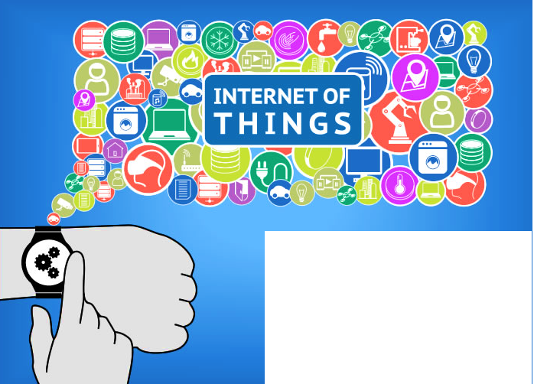
by
Dr. S.V.Srikanth
Joint Director
C-DAC
Notes:
The Internet revolutionized how people communicate and work together. It ushered in a new era of free information for everyone, transforming life in ways that were hard to imagine in its early stages. But the next wave of the Internet is not about people. It’s about intelligent, connected devices.

Slide 2
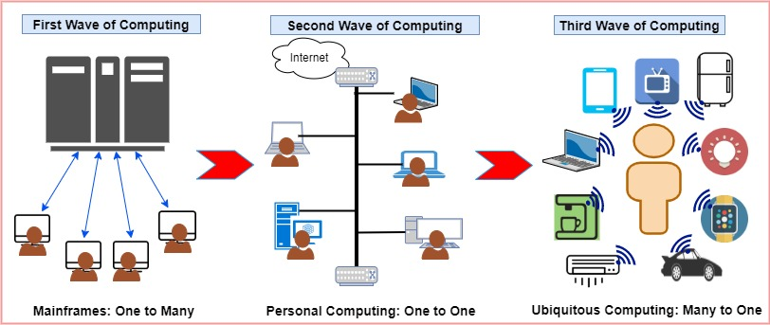
Computing Paradigms
Larger, powerful computers, large database, elaborate I/O hardware
Users logged in through remote terminals to execute programs
Genesis in IBM System/360 in 1964
Mini computers with individual processing power
Introduced BUS Architecture within to communicate with peripherals.
Networking enhanced it
PDP-8 from DEC pioneered it in 1964
Many computers serving an individual
Smaller, yet more powerful processors
Integrates sensing and actuation on-board
Early 90s by Mark Weiser
Notes:
Computing Paradigms –
Computing has evolved a long way in the past 50 years and is generally classified into 3 paradigms, also called waves of computing.
The First wave of computing, also called the Mainframe era, was introduced by IBM through their System/360 based computers. This wave focused on a “One-to-Many” operational structure where one computer served multiple users. Users logged into these machines and submitted their jobs for execution.
The mainframe systems were large, powerful, supporting large databases with elaborate I/O hardware to support multiple users.
The Second Wave was termed as the Personal computing era and started off close to the first wave in the early 1960s. This was pioneered by the Digital Electronic Corporation (DEC), through its PDP-8 Mini computer. This wave broke away from the traditional One to Many paradigm and introduced the “One-to-One” paradigm. A significant technological intervention in this wave was the development of the Bus architecture for communication between the processor and its peripherals. Each user had a powerful computer at his disposal and was therefore an independent entity in the entire architecture. The evolution of networking further enhanced the communication scenario in this wave, enabling users to interact with each other, seamlessly.
The Third wave of computing was coined by Mark Weiser of the Palo Alto Research Centre (PARC), Xerox in 1991 and is termed as Ubiquitous Computing. In this wave, a number of computers serve an individual, leading to a “Many to One” architecture.
In Weiser’s own words and I quote, “The most profound technologies are those that disappear. They weave themselves into the fabric of everyday life until they are indistinguishable from it.” unquote.
This paradigm opened up the spectrum for a number of technologies to intervene and provide multiple services to an individual user. Some of the significant inclusions of this era include smaller, powerful and feature rich processing, miniaturized sensing and sensing systems, wireless networking and actuation control, all in a single system. The world that we see around us today is a step in this direction. This wave paved the way for the Internet of Things which is another significant step in this direction.

Slide 3
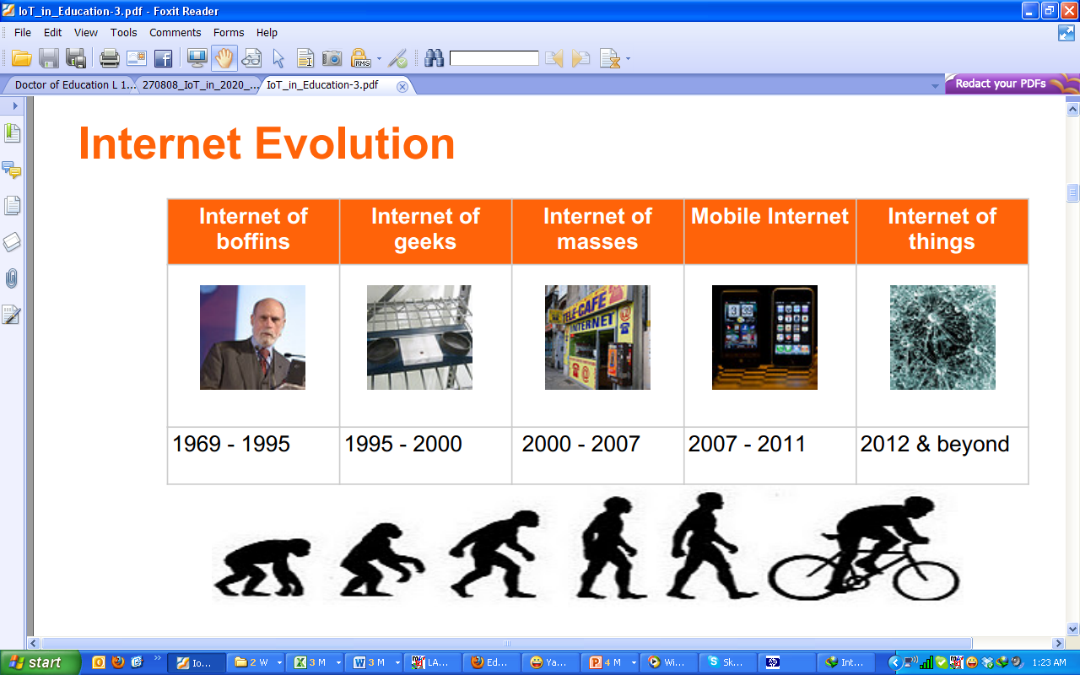
The Internet Evolution
1969 - 1995
1995 - 2000
2000 - 2010
2010 - 2020
2020 - beyond

Slide 4
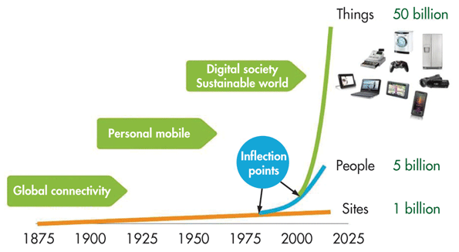
Evolution of Connected Computing

Slide 5




Things
We can turn almost every object into a “thing”.
A “thing” still looks much like an embedded system currently.
A “thing” has the following properties:
Power consumption is the main design issue.
1. a constraint device
2. It’s usually powered by battery. This implies limited source of energy.
3. It’s generally small in size and low in cost. This limits their computing capability.
4. It doesn’t usually perform complicated tasks.

Slide 6

Agenda
IoT History
IoT Definition
IoT Infographic
IoT Examples
IoT Concept and Architecture
IoT Case Studies
IoT Technology: Hardware/Software/Protocols
Idea to Prototype to Product

Slide 7
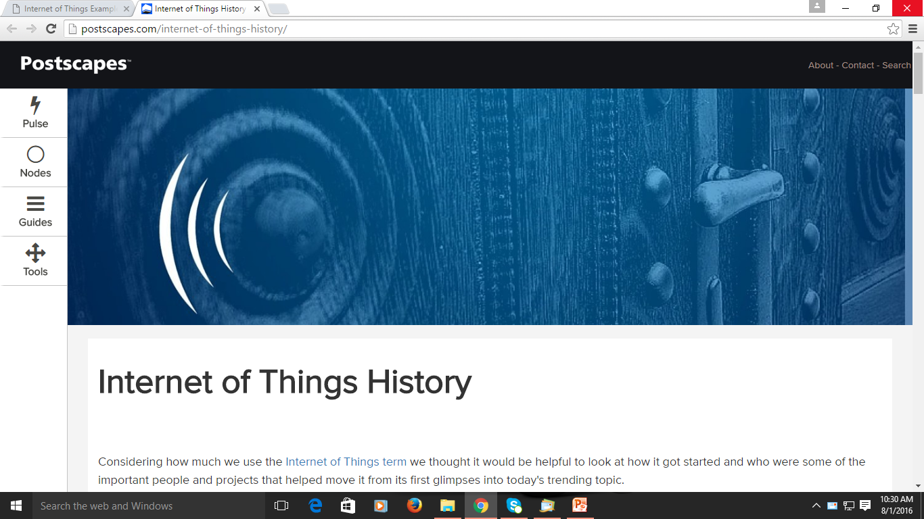
Internet of Things: History
“The more you know about the past, the better prepared you are for the future…..”
- Theodore Roosevelt

Slide 8

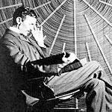
History of IoT
1832: An electromagnetic telegraph was created by Baron Schilling in Russia, and in 1833 Carl Friedrich Gauss and Wilhelm Weber invented their own code to communicate over a distance of 1200m within Gottingen, Germany.
1844: Samuel Morse sends the first Morse code public telegraph message "What hath God wrought?" from Washington, D.C. to Baltimore.
1926: Nikola Tesla in an interview with Colliers magazine: "When wireless* is perfectly applied the whole earth will be converted into a huge brain, which in fact it is, all things being particles of a real and rhythmic whole.........and the instruments through which we shall be able to do this will be amazingly simple compared with our present telephone. A man will be able to carry one in his vest pocket.“
1966: Karl Steinbach a German computer science pioneer said "In a few decades time, computers will be interwoven into almost every industrial product" 1969: Arpanet 1974: Beginnings of TCP/IP 1984: Domain Name System is introduced 1989: Tim Berners-Lee proposes the World Wide Web

Slide 9
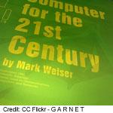
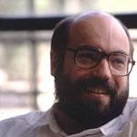
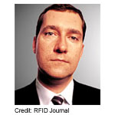

History of IoT
1990: John Romkey created the ‘First Internet Device’, a toaster that could be turned on and off over the Internet. At the October '89 INTEROP conference, Dan Lynch, President of Interop promised Romkey that, if Romkey was able to "bring up his toaster on the Net," the appliance would be given star placement in the floor-wide exhibitors at the conference.
1991: The first web page was created by Tim Berners-Lee
1991: Mark Weiser's Scientific American article on ubiquitous computing called ‘The Computer for the 21st Century’ is written. “The most profound technologies are those that disappear. They weave themselves into the fabric of everyday life until they are indistinguishable from it”.
1995: The Internet goes commercial with Amazon and Echobay (Ebay)
1997: Paul Saffo's prescient article "Sensors: The Next Wave of Infotech Innovation" (Via: Geoffrey Barrows)
1998: Google is incorporated
1999 - A big year for the IoT and MIT The Internet of Things term is coined by Kevin Ashton executive director of the Auto-ID Center: "I could be wrong, but I'm fairly sure the phrase "Internet of Things" started life as the title of a presentation I made at Procter & Gamble (P&G) in 1999. Linking the new idea of RFID in P&G's supply chain to the then-red-hot topic of the Internet was more than just a good way to get executive attention. It summed up an important insight which is still often misunderstood."
Mark Weiser
Kevin Ashton

Slide 10

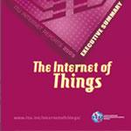
History of IoT
1999: Auto-ID Labs opens which is the research-oriented successor to the MIT Auto-ID Center, originally founded by Kevin Ashton, David Brock and Sanjay Sarma. They helped develop the Electronic Product Code or EPC, a global RFID-based item identification system intended to replace the UPC bar code.
2000: Starting off what is now becoming a meme, LG announces it's first Internet refrigerator plans.
2003-2004: The term is mentioned in main-stream publications like The Guardian, Scientific American and the Boston Globe. - Projects like Cooltown, Internet0, and the Disappearing Computer initiative seek to implement some of the ideas, and the Internet of Things term starts to appear in book titles for the first time. - RFID is deployed on a massive scale by the US Department of Defense in their Savi program and Walmart in the commercial world.
2005: The IoT hit another level when the UN's International Telecommunications Union ITU published its first report on the topic. 2006-2008: Recognition by the EU, and the First European IOT conference is held
2008-2009: The Internet of Things was "Born"

Slide 11
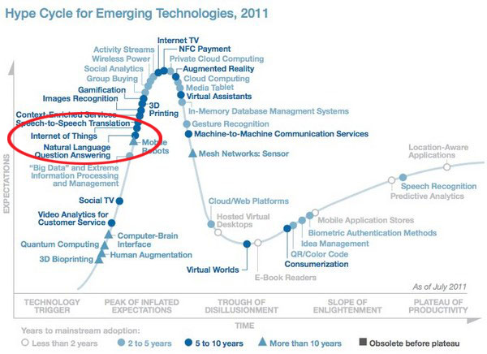
History of IoT
2011: IPV6 public launch - The new protocol allows for 2¹²⁸ (approximately 340 undecillion or 340,282,366,920,938,463,463,374,607,431,768,211,456) addresses or as Steven Leibson put it, “we could assign an IPV6 address to every atom on the surface of the earth, and still have enough addresses left to do another 100+ earths.”

Slide 12
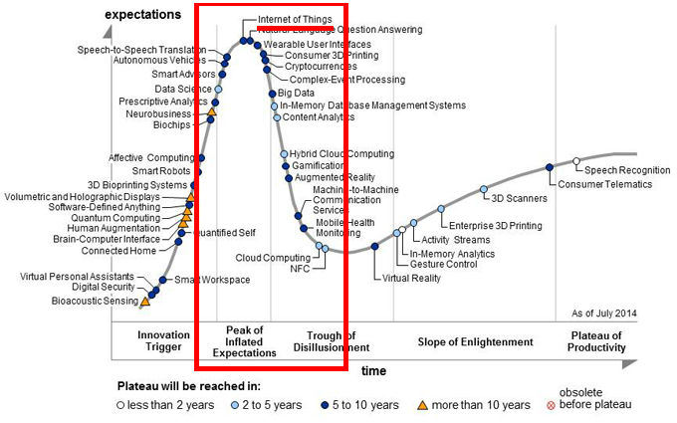
Finally IoT……

Slide 13
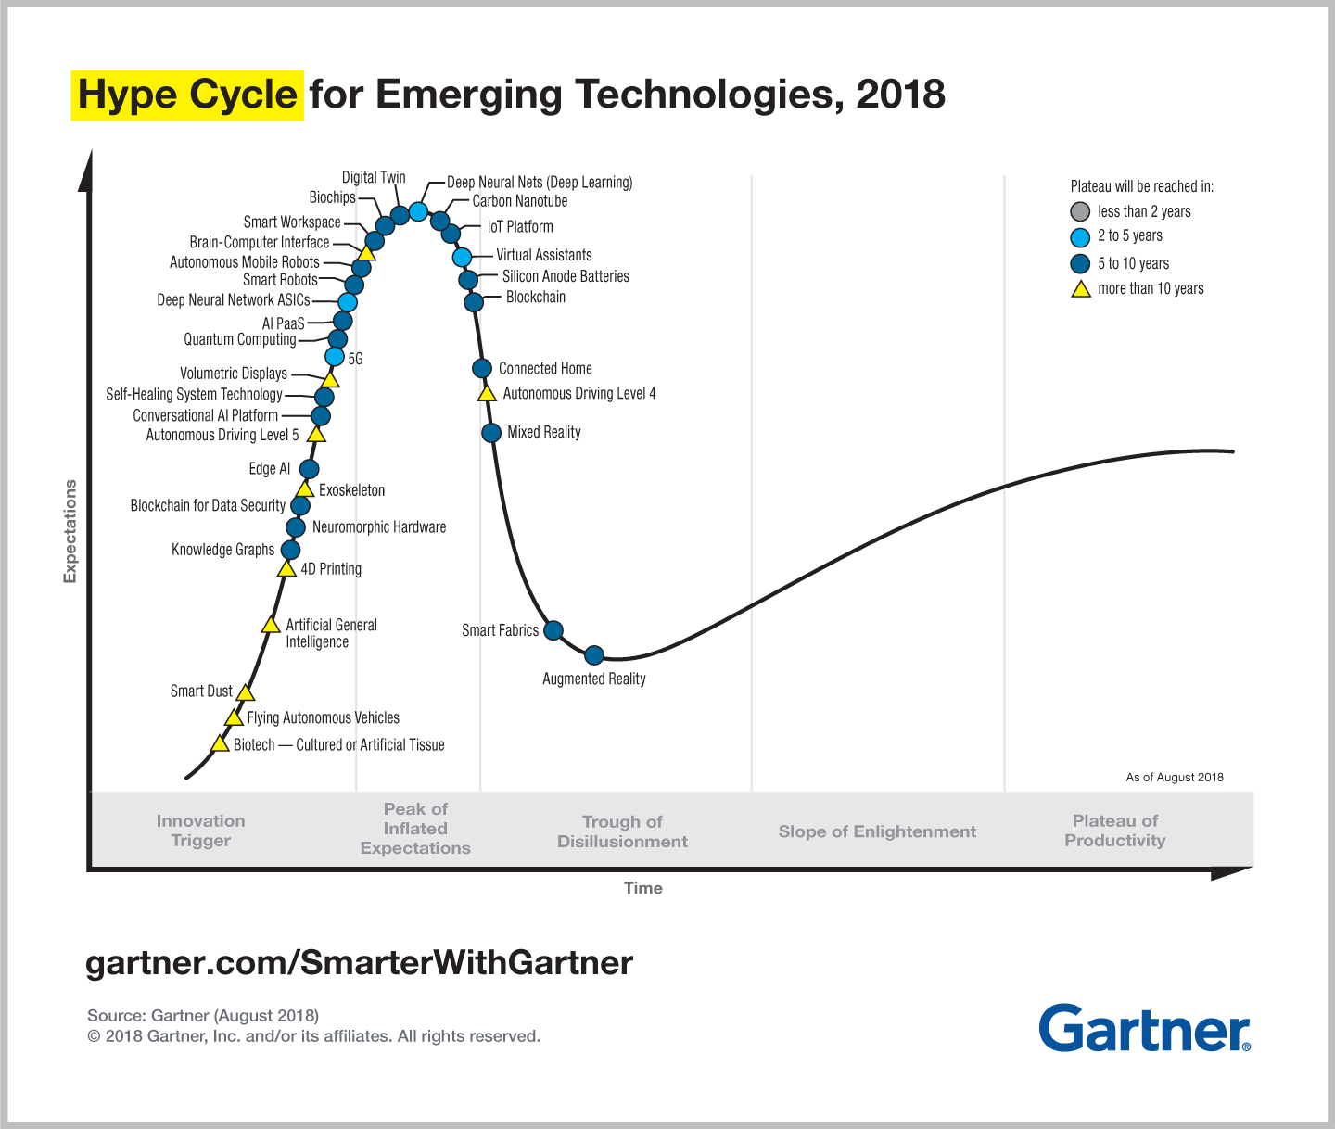
@2018

Slide 14
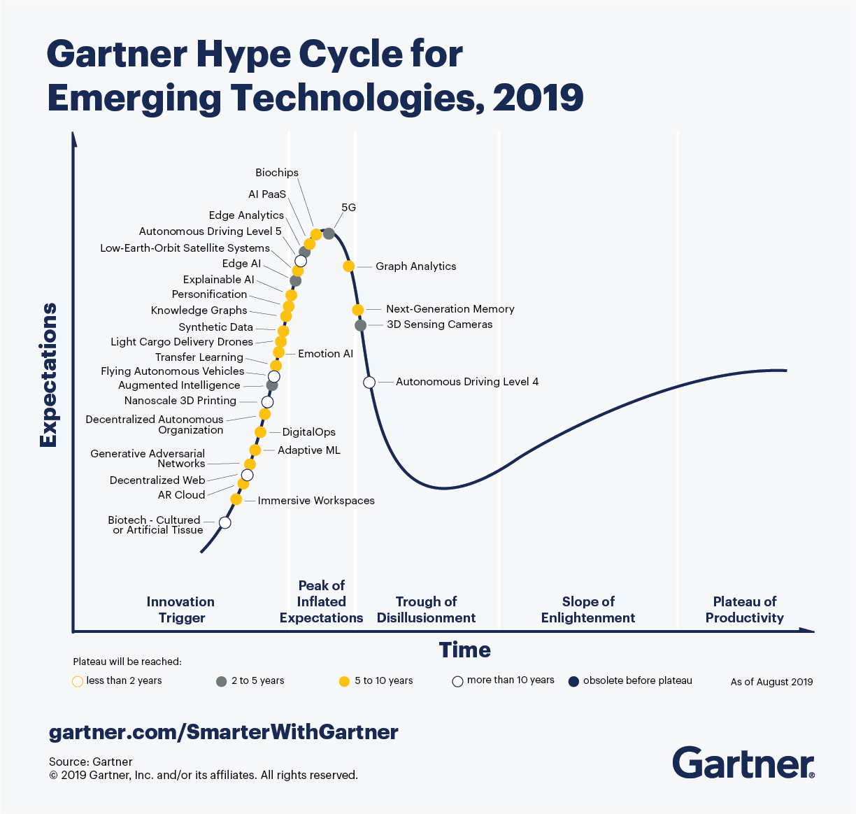
@Present

Slide 15
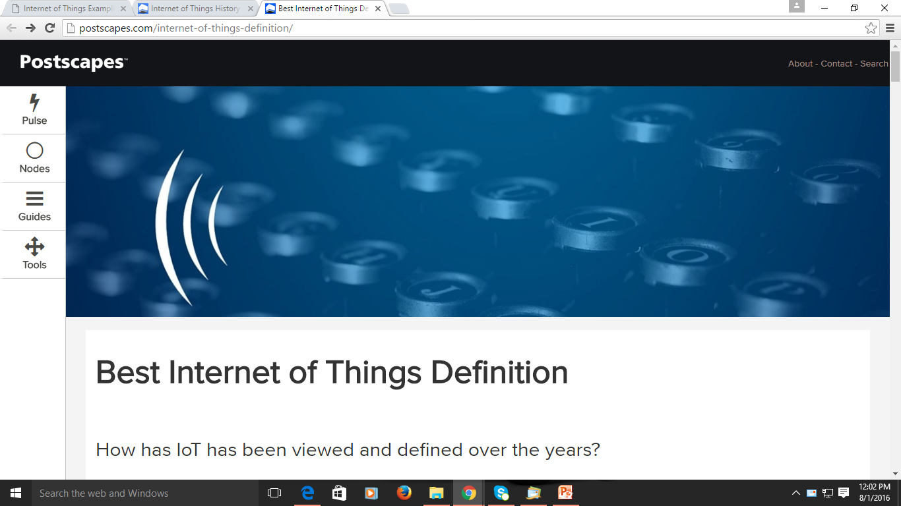
Internet of Things (IoT)
Definition

Slide 16
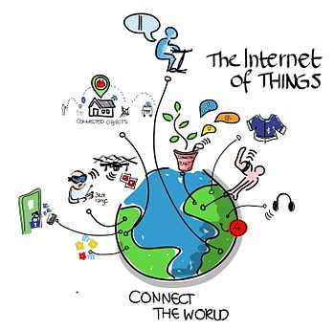
Internet of Things (IoT)
Coined by Kevin Ashton in 1999
Refers to uniquely identifiable objects and their virtual representations in an Internet like structure

Slide 17
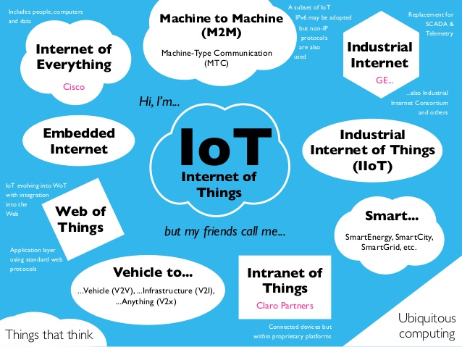
Some IoT Concepts…..

Slide 18
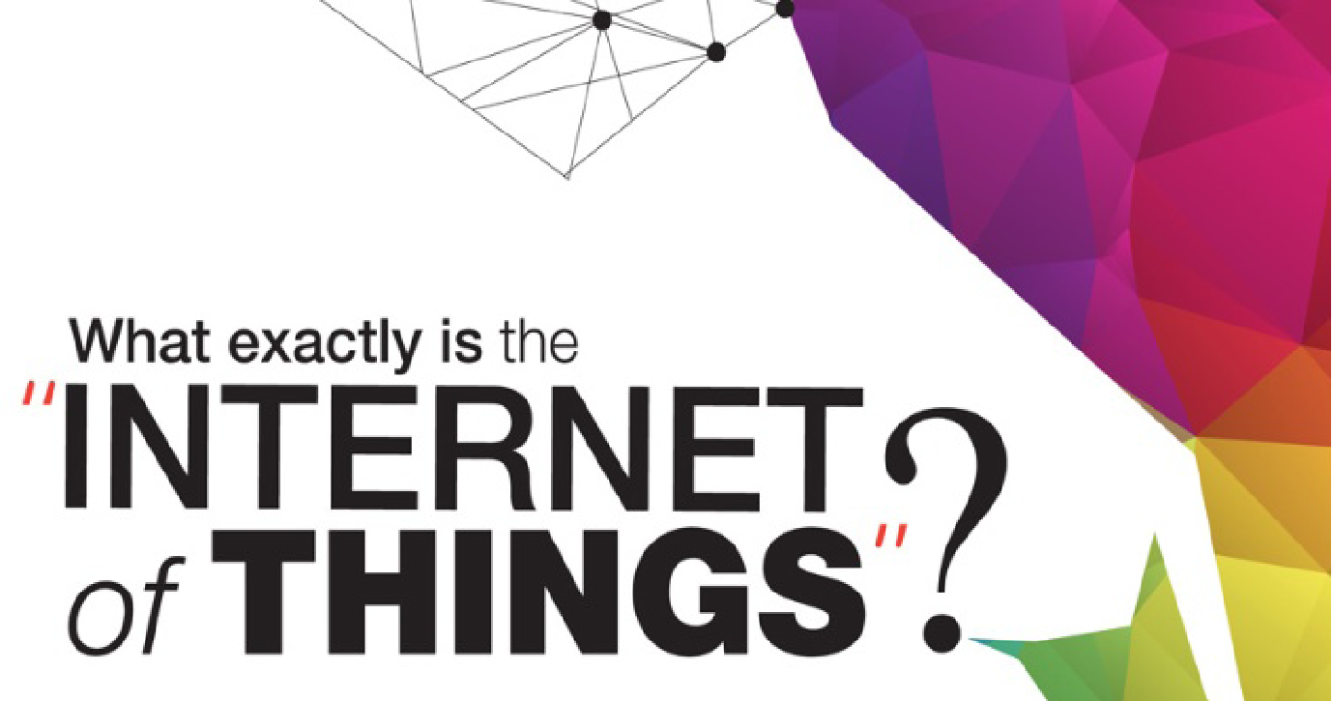

Slide 19
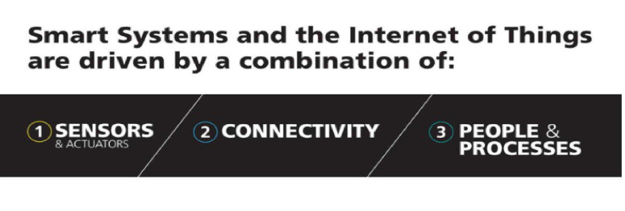

Slide 20
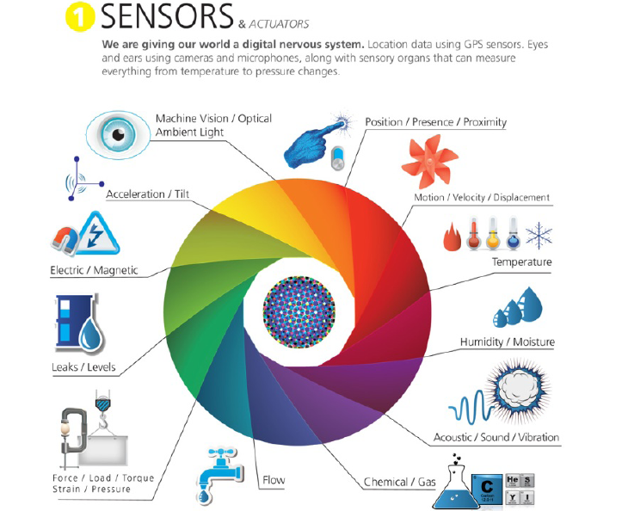

Slide 21
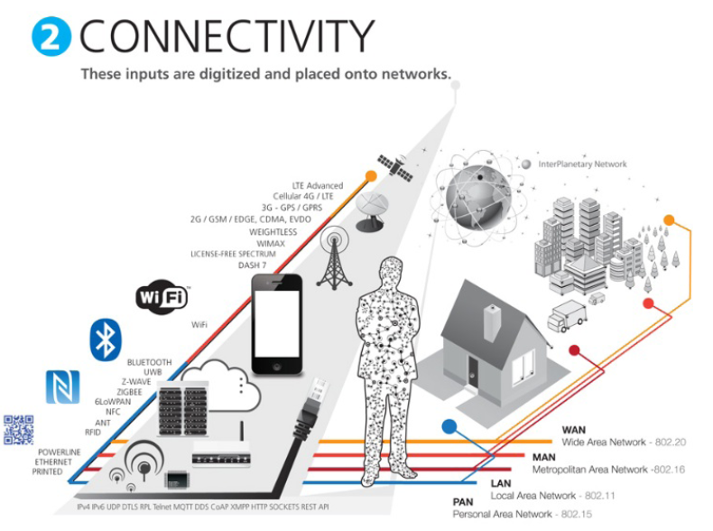
Now LPWAN

Slide 22
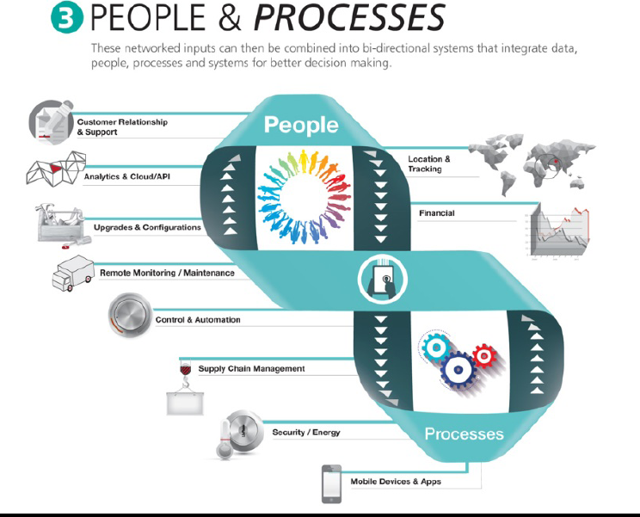

Slide 23
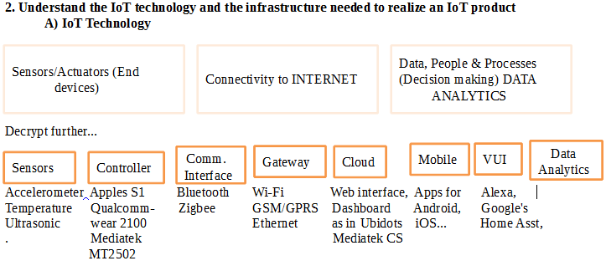
IoT Components: Decrypt Further

Slide 24
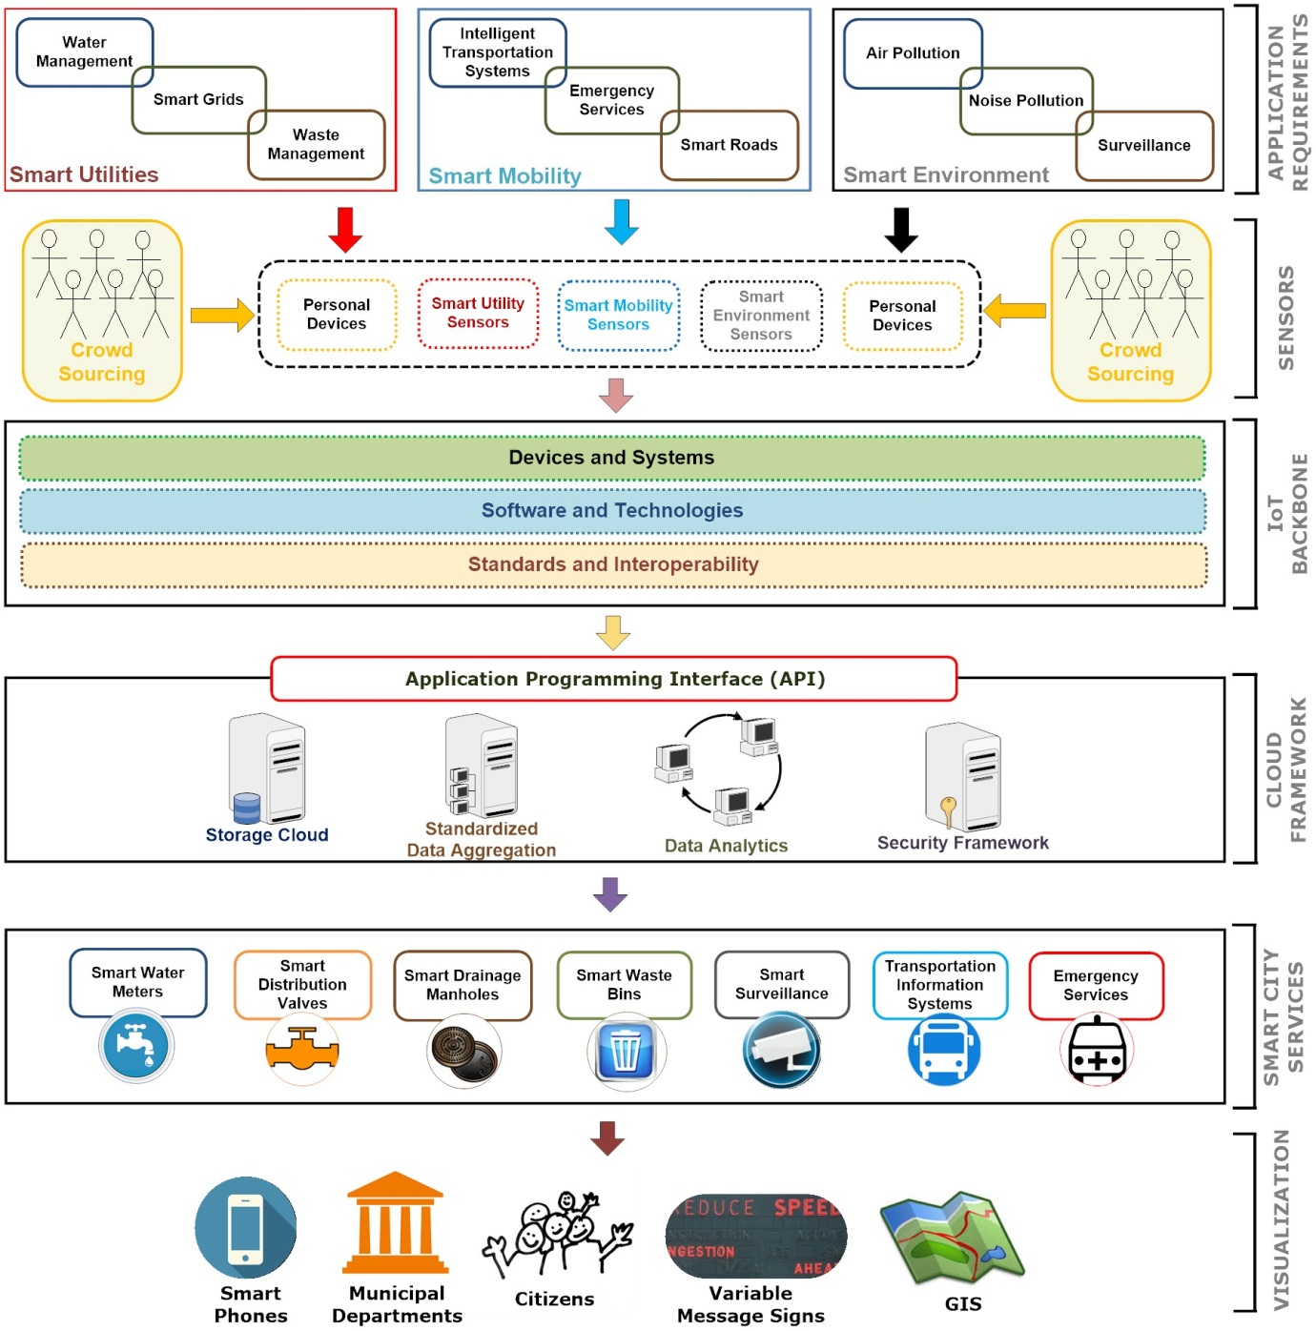

Slide 25
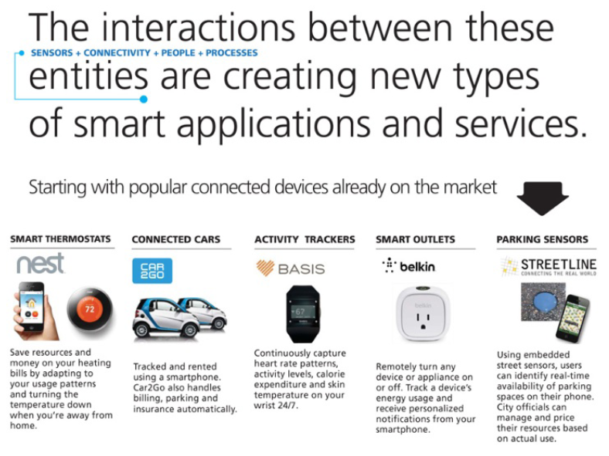

Slide 26
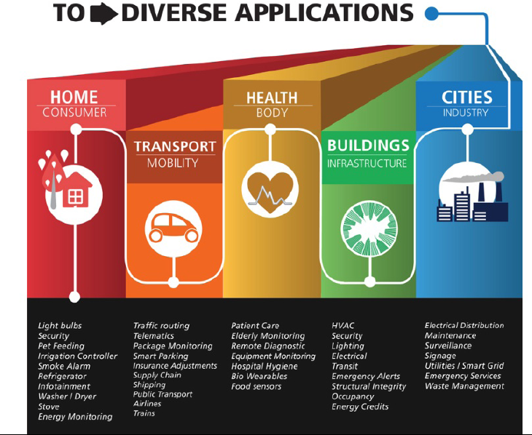
AND QUICKLY ADVANCING

Slide 27
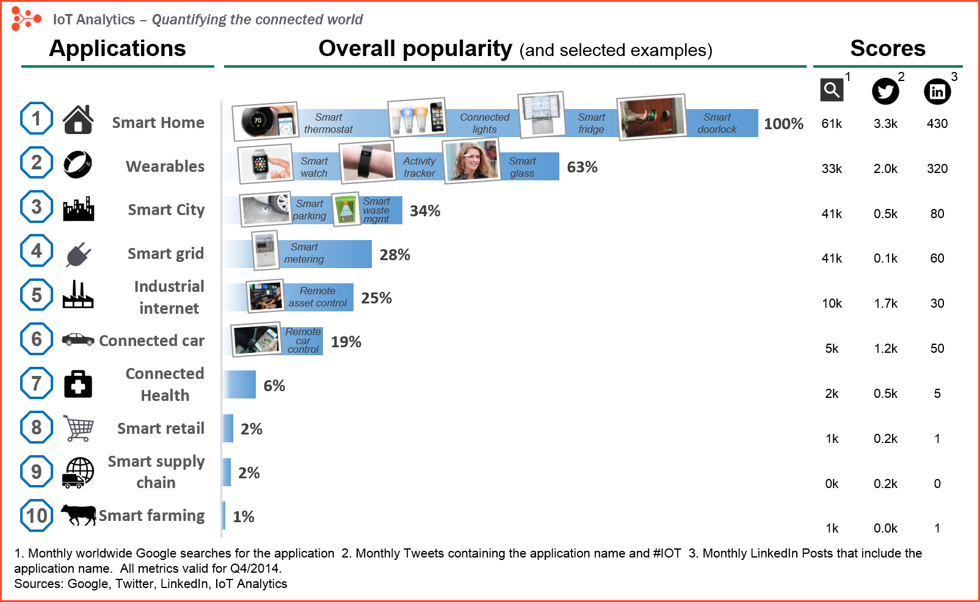
IOT APP’s Popularity:2014
Source: https://iot-analytics.com/10-internet-of-things-applications/

Slide 28
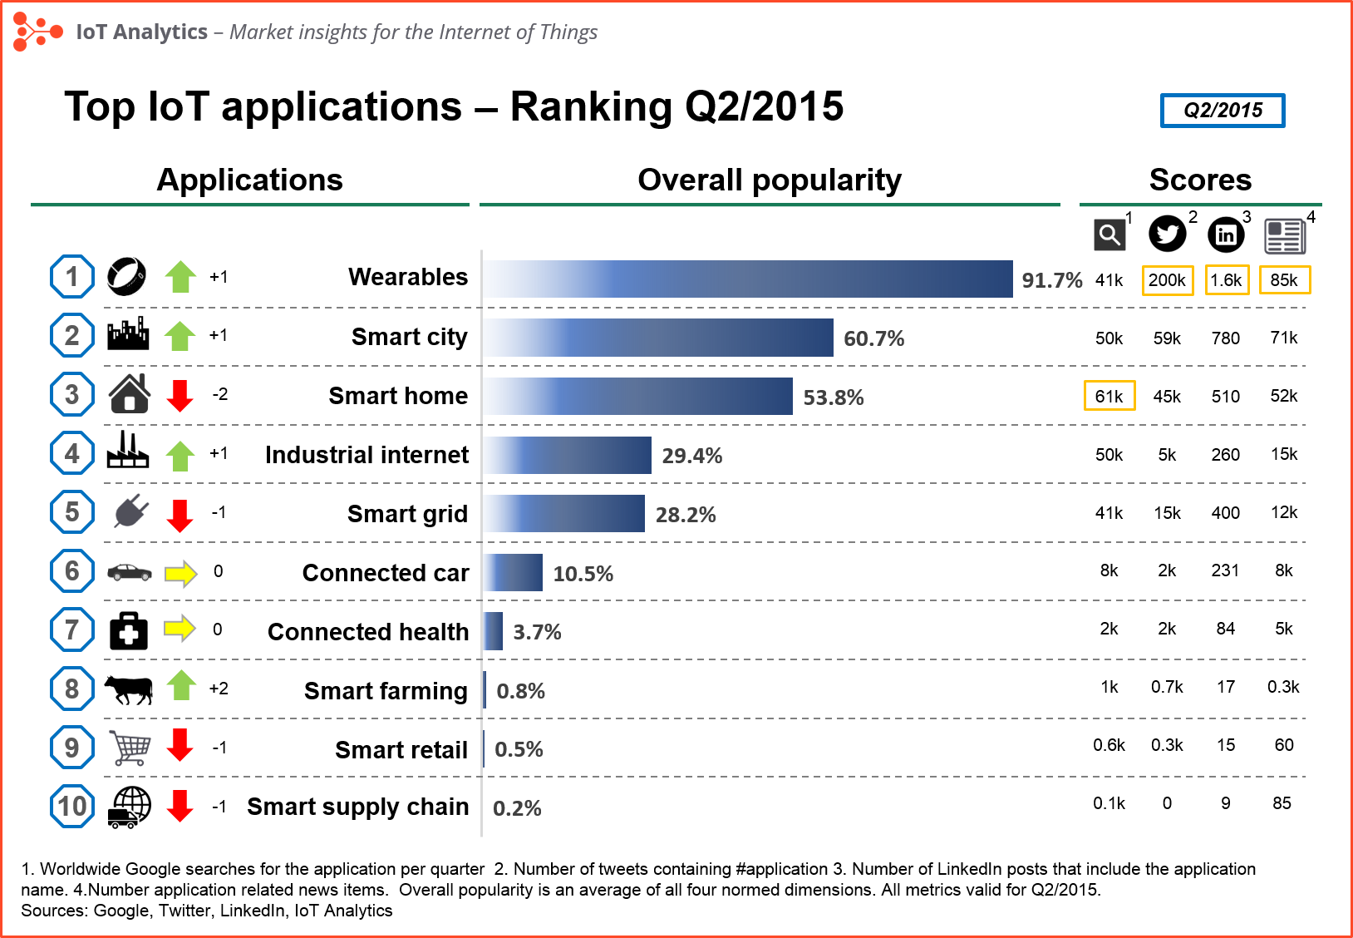
IOT APP’s Popularity:2015
Source: https://iot-analytics.com/10-internet-of-things-applications/

Slide 29
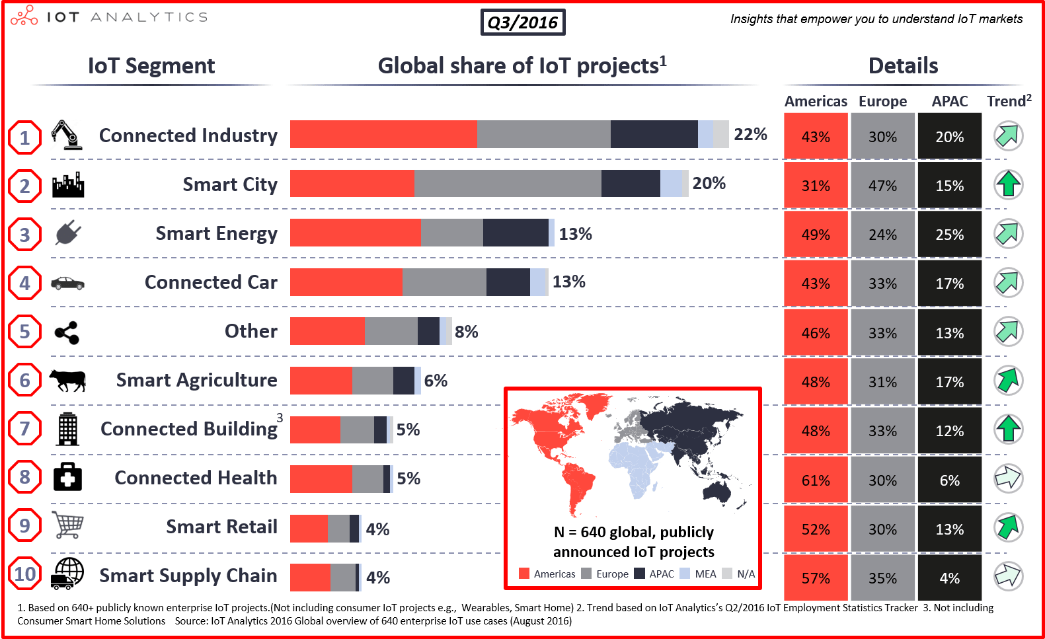
IoT Segment Popularity: 2016
Source: https://iot-analytics.com/top-10-iot-project-application-areas-q3-2016/

Slide 30
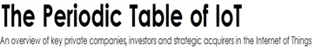
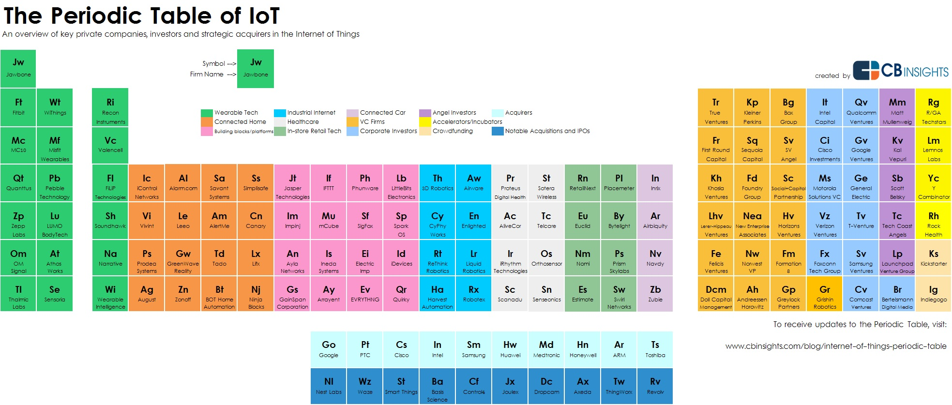

Slide 31

YOUR BODY
Sensors + Connectivity

Slide 32

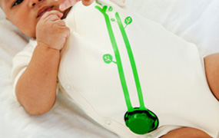
CHECK ON THE BABY
Aimed at helping to prevent SIDS, the Mimo monitor is a new kind of infant monitor that provides parents with real-time information about their baby's breathing, skin temperature, body position, and activity level on their smartphones.

Slide 33


REMEMBER TO TAKE YOUR MEDS
GlowCaps fit prescription bottles and via a wireless chip provide services that help people stick with their prescription regimen; from reminder messages, all the way to refill and doctor coordination.

Slide 34
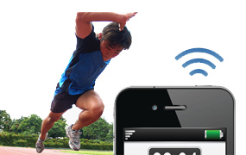
Health Trackers
TRACK YOUR ACTIVITY LEVELS
Using your smartphone's range of sensors (Accelerometer, Gyro, Video, Proximity, Compass, GPS, etc) and connectivity options (Cell, WiFi, Bluetooth, NFC, etc) you have a well equipped Internet of Things device in your pocket that can automatically monitor your movements, location, and workouts throughout the day.

Slide 35

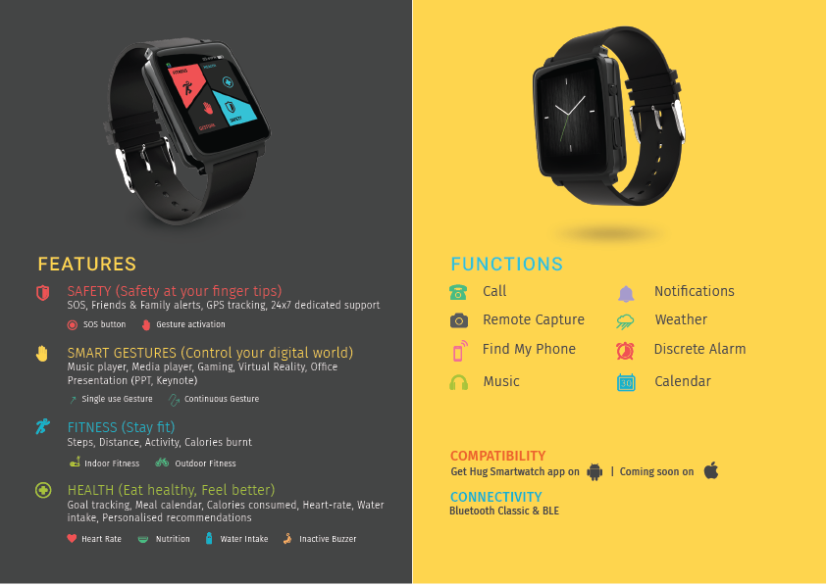

Slide 36

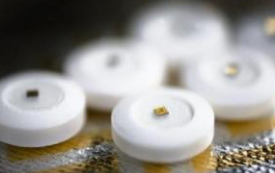
GET THE MOST OUT OF YOUR MEDICATION
The Proteus ingestible pill sensor is powered by contact with your stomach fluid and communicates a signal that determines the timing of when you took your meds and the identity of the pill. This information is transferred to a patch worn on the skin to be logged for you and your doctor's reference. Heart rate, body position and activity can also be detected.

Slide 37

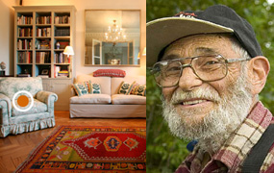
MONITOR AN AGING FAMILY MEMBER
Using a wearable alarm button and other discrete wireless sensors placed around the home, the BeClose system can track your loved one's daily routine and give you peace of mind for their safety by alerting you to any serious disruptions detected in their normal schedule.

Slide 38

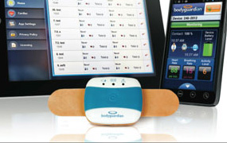
STAY OUT OF THE DOCTOR'S OFFICE
Intended for individuals with cardiac arrhythmias the BodyGuardian is an FDA cleared wearable sensor system that can remotely read a patient’s biometrics (ECG, heart rate, respiration rate and activity Level), sending the data to the patients physician and allowing users to go about their daily lives outside of a clinical setting..

Slide 39

YOUR HOME
Remotely monitor and manage your home and
cut down on your monthly bills and resource usage

Slide 40

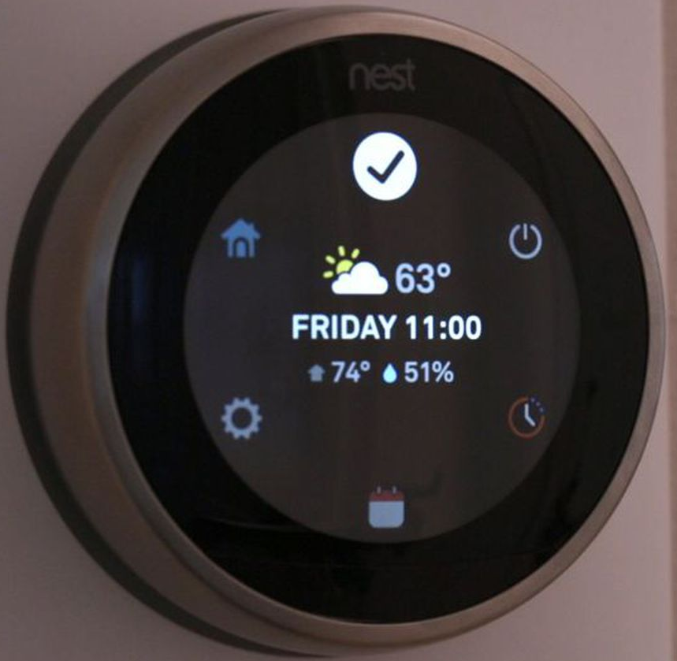
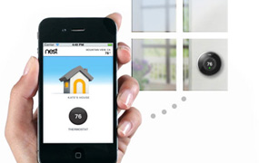
HEAT YOUR HOME EFFICIENTLY
Smart thermostats like the Nest use sensors, real-time weather forecasts, and the actual activity in your home during the day to reduce your monthly energy usage by up to 30%, keeping you more comfortable, and offering to save you money on your utility bills.

Slide 41

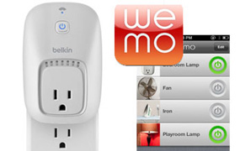
MAKE SURE THE OVEN IS OFF
Smart outlets like the WeMo allow you to instantly turn on and off any plugged in device from across the world or just your living room. Save money and conserve energy over time by eliminating standby power, measure and record the power usage of any device, and increase its operating lifespan through more efficient use and scheduling.

Slide 42
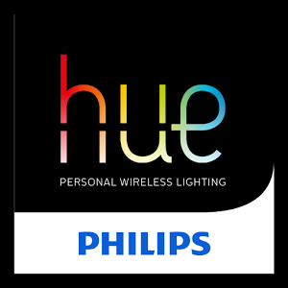
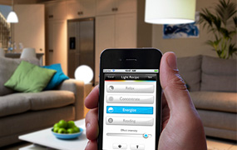
LIGHT YOUR HOME IN NEW WAYS
Web enabled lights like the Phillip's Hue can be used as an ambient data displays (Glow red when my bus is 5 minutes away). These multi-functional lights can also help you to reduce electricity use (automatically turn off the lights when no one is in a room) or help to secure your home while you are away by turning your lights on and off.

Slide 43
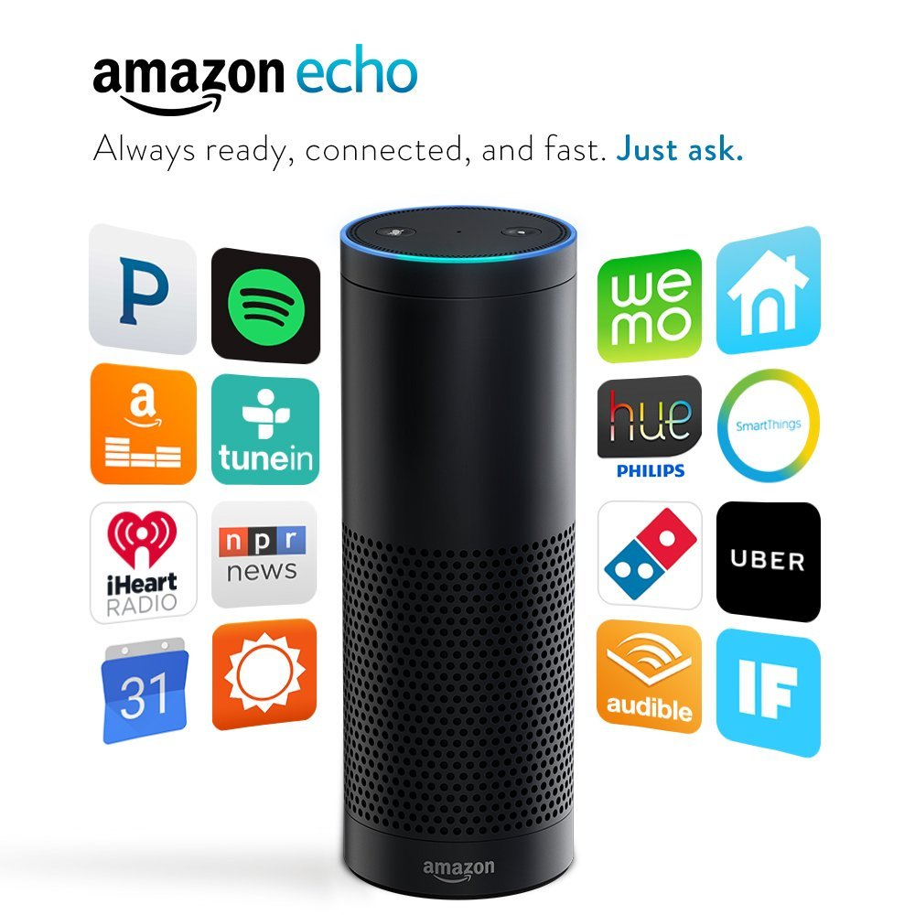
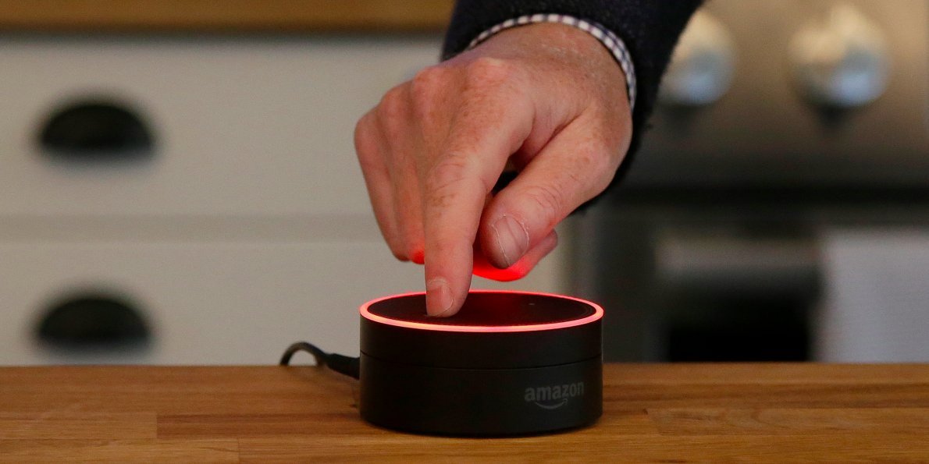
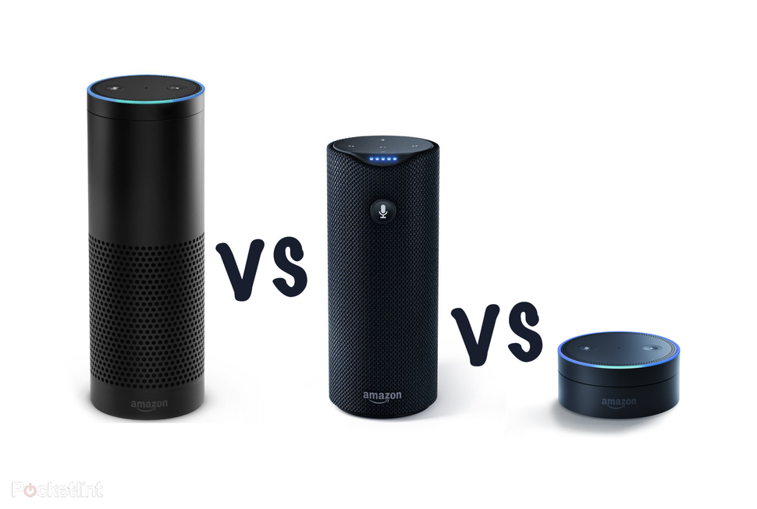
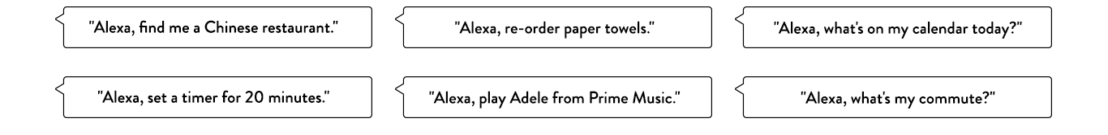

Slide 44
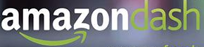
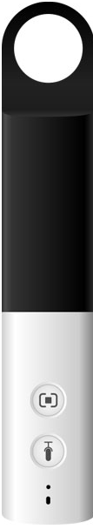
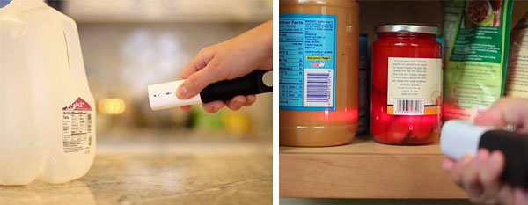
Shopping Made Simple
The idea is that customers will keep Dash hanging on the fridge or sitting out on the kitchen counter. When the pantry starts to run low of something -- or you get inspired by a recipe that needs exotic new ingredients -- you’ll reach for Dash and either tell it what you want, or scan the barcode of the product you’re ready to replace.

Slide 45
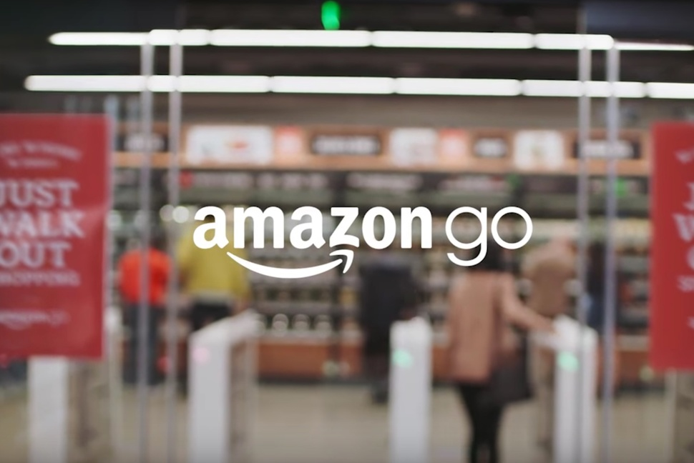



No lines. No checkouts. … No cashier jobs?

Slide 46


TRACK DOWN THOSE LOST KEYS
You can easily track down those lost keys or cell phone in your house using Bluetooth and other wireless technology devices like the Cobra Tag..

Slide 47


KEEP YOUR PLANTS ALIVE
Whether taking care of a small hydroponic system or a large backyard lawn, systems like HarvestGeek with their suite of sensors and web connectivity help save you time and resources by keeping plants fed based on their actual growing needs and conditions while automating much of the labor processes.

Slide 48

YOUR CITY
Engage with the data exhaust produced from your city and neighborhood

Slide 49


KEEP STREETS CLEAN
Products like the cellular communication enabled Smart Belly trash use real-time data collection and alerts to let municipal services know when a bin needs to be emptied. This information can drastically reduce the number of pick-ups required, and translates into fuel and financial savings for communities service departments.

Slide 50


STOP DRIVING IN CIRCLES
With the use of installed sensors, mobile apps, and real-time web applications like those provided in Streetline’s ParkSight service, cities can optimize revenue, parking space availability and enable citizens to reduce their environmental impact by helping them quickly find an open spot for their cars.

Slide 51

dontflush.me
RECEIVE POLLUTION WARNINGS
The DontFlushMe project by Leif Percifield is an example that combines sensors installed in Combined Sewer Overflows (CSOs) with alerts to local residents so they can avoid polluting local waterways with raw sewage by not flushing their toilets during overflow events.

Slide 52


USE ELECTRICITY MORE EFFICIENTLY
The SenseNET system uses battery-powered clamp sensors to quickly measure current on a line, calculate consumption levels, and send that data to a hosted application for analysis. Significant financial and energy resources are saved as the clamps can easily identify meter tampering issues, general malfunctions, and any installation issues in the system.

Slide 53


LIGHT STREETS MORE EFFECTIVELY
This smart lighting system from Echelon allows a city to intelligently provide the right level of lighting needed by time of day, season, and weather conditions. Cities have shown a reduction in street lighting energy use by up to 30% using solutions like this.

Slide 54


SHARE YOUR FINDINGS
AirCasting is a platform for recording, mapping, and sharing health and environmental data using your smartphone. Each AirCasting session lets you capture real-world measurements (Sound levels recorded by their phone microphone; Temperature, humidity, carbon monoxide (CO) and nitrogen dioxide (NO2) gas concentrations), and share it via the CrowdMap with your community.

Slide 55


Slide 56

INDUSTRY
Optimize operations, boost productivity and save in resources and costs

Slide 57

Industrial Internet of Things (IIoT)
MAINTAIN & REPAIR
Sensors installed inside equipment will monitor if any parts have exceeded their designed thresholds, and will automatically send reports to owners and manufacturers if they have. Early predictions on equipment malfunctions can be made with parts and service maintenance can be automatically scheduled ahead of a an actual part failure.

Slide 58


STOP GUESSING
Retailers can run real-world A/B tests using networked cameras and sensors like those in the Shopperception system to detect how customers are engaging with specific products and the store's layout.

Slide 59

MONITOR
Smart Structures’ SmartPile technology is an example in action that uses wireless sensors embedded within concrete foundation piles to ensure the quality and integrity of a structure. These sensors can provide load and event monitoring for the projects construction both during and after its completion.

Slide 60


KEEP TRACK OF YOUR ASSETS
The OnFarm solution combines real-time sensor data from soil moisture levels, weather forecasts, and pesticide usage from farming sites into a consolidated web dashboard. Farmers can use this data with advanced imaging and mapping information to spot crop issues and remotely monitor all of the farms assets and resource usage levels.

Slide 61



Slide 62


SAFETY FIRST
Enguage offers an electronic system that notifies authorities when a fire extinguisher is blocked, missing from its designated location or when its pressure falls below safe operating levels. Alerts can be sent directly through an instant email, phone call or pager notification to proper agencies and supervisors.

Slide 63

THE ENVIRONMENT
Understand and better manage what we currently have

Slide 64




Slide 65


MONITOR POLLUTION LEVELS
The Air Quality Egg is a community-led air quality sensing system designed to allow anyone to collect high resolution readings of NO2 and CO concentrations outside of their home using an RF transmitter and Ethernet driven base station. The data can then be shared to create a network of readings to be used by the community and general public.

Slide 66

Floating Sensor Network
TRACK WATER
The University of Berkeley's Floating Sensor Network project uses motorized drifters (Outfitted with cell communication, GPS, temperature, and salinity sensors) that can be quickly deployed in response to unanticipated events such as floods to track the movement of water, contaminants, and other conditions in waterways.

Slide 67


GROUND Lab
HELP PROTECT WILDLIFE
A project by Ground Labs and Lion Guardians is creating an open source wildlife tracking collar system to safeguard the Maasai herders cattle and protect the last 2000 lions living Southern Kenya. The system consists of a tracking collar that utilizes a GPS/GSM module to locate and track the lions and communicate their coordinates to researchers and Maasai herders via SMS."

Slide 68


GET AN ADVANCED WARNING
The University of Loughborough’s Acoustic Landslide Detector system called ALARMS (Assessment of Landslides using Acoustic Real-time Monitoring Systems), detects high-frequency stress waves produced by soil movement. They can be used to calculate soil movement in real time and send out alerts to communities before an event occurs.

Slide 69

Bumblebee
KNOW THE VARIABLES
Nik Sargent's Bumblebee project sheds light on how the environment influences bees activity patterns and behaviors using sensors (visual, audio, temperature, sunlight, weather) and web technology to monitor and record their daily lives.

Slide 70

Invisible Tracck
STOP THE BLEEDING
Invisible Tracck is a wireless device being used in pilot programs to help combat illegal deforestation taking place in the Amazon. The battery operated devices are installed on select trees and as soon as the logged trees are in transit and able to connect to a mobile network (Up to a 20 mile range), an alert notification with location coordinates is sent to the Brazilian Institute of Environment so they can take action.

Slide 71

Learn More About How IoT is Changing the Game

Slide 72





A computer of the size of button! 32 bit microprocessor, 384 KB of Flash, 80KB of SRAM + 6 axis combo sensor with accelerometer and gyroscope, Bluetooth Low energy (BLE), PMIC... all integrated as a module!!
Processor Architecture: x86 !!!

Slide 73

The Connected Battlespace

Slide 74


Promising target scenarios: Defense and Public safety

Slide 75

IoT Proliferation

Slide 76
C-DAC Initiatives
Objectives | Hardware outcomes | Software
Smart Waste management | Smart bins and manholes | Software supporting the scheduling and priority based collection
Smart Water Distribution | Water meter with quality measurement and remote controllable valves | Identify consumption patterns, water quality and detect leakages in real-time, leading to water conservation
Smart Electrical Distribution | IEC61850 based merging unit and IED, Smart meter, Smart plug, Solar energy interface to Grid | Optimize energy delivery by monitoring demand requirements of the grid dynamically through a variety of sensor enabled devices
Smart Transportation Management Systems | Intelligent traffic signal controller Intelligent parking management system | A one-stop site that furnishes city wide travel information, given the origin and destination stations. Also hosts traffic information and path optimization through real-time updates
Emergency Services |  | Optimal resource management and distribution, response planning of various emergency services, emergency vehicle prioritization
Air & Noise Pollution | Handheld air and noise pollution device | Monitor city pollution levels and provide warnings, to city planner and authorities
Surveillance |  | Scalable Image processing solution using video cameras for city surveillance

Slide 77


Technology
Communication
Backbone
Hardware
Protocols
Software
Cloud Platforms

Slide 78
Specific issues pertaining IoT Nodes
Limited processing power
Battery operated, so must be power miser, sleeping capabilities highly desireable
Robust, deployable in harsh environment
Weatherproof
Easy to configure
Inexpensive, deployable in great numbers

Slide 79

IoT Network Topologies
Notes:
The IoT Network Topologies
The IoT nodes can also be classified into one of three popular network topologies namely, Mesh topology depicted in orange in the figure, Star topology depicted in turquoise and the standalone topology, depicted in blue.
In a mesh topology, the nodes network among themselves using mesh protocols. In a mesh protocol, provision is made for each node to be connected either directly or indirectly to every other node using routing algorithms. Since all nodes are connected in the mesh, they all need not be in the vicinity of the gateway. Data from the farthest node is relayed to the gateway using a multi-hop routing protocol, which increases the network coverage.
The star topology requires each node to be connected to the gateway through a peer-to-peer connection or a direct link, without any intermediary forwarder. This implies that all nodes in the network have to be within the radio range of the gateway for successful communication to happen. These networks are simpler to implement, but require long range wireless radios to ensure useful uses.
In the standalone topology, there is no need for a gateway. The node can directly communicate with the cloud using a WAN kind of wireless communication protocol.
From the standpoint of power consumption, the star topology consumes the lowest power because the nodes can be duty cycled. For the mesh network to be power aware, all nodes require some form of network time synchronization to ensure they all sleep and wake up at the same time, thereby conserving power. The standalone topology can also be power aware, but in comparison to the star topology it is generally higher because the nature of the wireless communication will be inherently power hungry

Slide 80
Key considerations to be made during the development of an IoT System
Power Consumption
Multiple Devices – End Nodes (Sensors & Actuators), Gateways
System & Network Architectures
Battery based device architectures
Long Battery Life
Energy Harvesting
Stand-alone operations
Low Device Cost
Deployment & Networking Requirements
Remote - Configuration and Network Management
Packaging
Low Deployment Cost &
Ease of Deployment
Coverage Area
Support for large number of devices
Notes:
The key considerations to be made while developing an IoT System
Some of the important design considerations to be made for an IoT system include the Power Consumption, Battery based device architectures, Deployments & Networking requirements, Coverage Area, Support for massive number of autonomous & stand-alone devices and low device cost.
Primarily Low Power consumption is the most important design consideration for an IoT system. This is particularly important for deployments in outdoor and remote application sites. Since there are multiple devices in the system architecture like End nodes and Gateways, the power consumption at each of these has to be carefully planned and budgeted. End nodes generally interface sensors. In this scenario, it may be possible to conserve power by duty cycling the device. But, if the end device includes an actuator duty cycling it may introduce latency into the system response which may be undesirable.
The low power operations of the IoT are also dependent on the system and network architectures, as discussed earlier. Based on whether the topology of the network is mesh or star or stand-alone, the power consumption varies.
Most IoT devices require to operate with a battery as its source of power. It is therefore important that the system design ensures that the battery use is optimal, so as to provide adequate sustenance without having to frequently replace it. Additionally, where ever possible, energy harvesting methods can be employed to ensure greater power sustainability of the device. The system design should however consider algorithms that optimize battery consumption. It may also be advisable to design with a secondary battery in the system to ensure that it is able to survive a primary battery failure.
The Deployment scenario is another important aspect of the IoT system architecture. Most IoT deployments are expected to be in remote sites. Therefore networking and network management become fundamental. Since remote operations are important, the deployment architecture should facilitate for remote configurations, firmware updates and device health monitoring. Device packaging forms another important consideration and conformance to environmental protection standards is a pre-requisite for the deployment to be successful. The networking should ensure that these are adequately addressed, as according to the application requirements.
Other aspects like coverage area, support for massive number of devices, stand-alone operations and low device cost are also important considerations in the system design.

Slide 81

Key Requirements for IoT Communication…..
Long battery life
Low device cost
Low deployment cost
Extended coverage
Support for a massive number of devices

Slide 82

IoT Communication

Slide 83

IoT Communication

Slide 84





A few Communication technologies…..

Slide 85
Wireless Communication Radios and Protocols
Important Enabler of the IoT
Overwhelming number of connectivity options
Wireless Local Area Networks (WLAN)
WiFi – IEEE 802.11 a, b, g, n, ah
Wireless Personal Area Networks
Bluetooth Low Energy (BLE) – IEEE 802.15.1
Low Rate Wireless Personal Area Networks (LR-WPAN) – IEEE 802.15.4
Low Power Wide Area Networks (LPWAN)
Cellular / Mobile IoT
LPWA: LTE Cat-M, NB-IoT
Non-Cellular Alternatives
LoRa, Sigfox, Weightless, RPMA

Slide 86

Electromagnetic Spectrum
RF range
Government regulations make specific ranges of the electromagnetic spectrum available for communication
A license is required to operate transmission equipment in some parts of the spectrum
Some parts are unlicensed

Slide 87
ISM Bands
Industrial, Scientific, and Medical frequency bands
Can operate without FCC licenses
Tx output power ≤ 1 watt
Eliminate cost and time consuming for licenses
915 MHz*
2.45 GHz
5.8 GHz
26
MHz
100 MHz
150 MHz
902
MHz
928
MHz
2.40
GHz
2.50
GHz
5.725
GHz
5.875
GHz
* Region 2 only

Slide 88
Wireless LANs: IEEE 802.11 (Wi-Fi)

Slide 89



IEEE 802.11
IEEE Standard for Wireless LANs
Covers both physical and data link layers
Wi-Fi Access points
Wi-Fi Router

Slide 90
WLAN Architectures
Basic Service Set (BSS)
Extended Service Set (ESS)

Slide 91

Basic Service Set (BSS)
(Ad hoc mode)
(Infrastructure mode)

Slide 92

Extended Service Set (ESS)

Slide 93
IEEE 802.11 Physical Layer
IEEE 802.11 MAC
802.11
802.11a
802.11b
802.11g
802.11n
1-2 Mbps 2.4 GHz FHSS DSSS IR
6-54 Mbps 5 GHz OFDM
1-11 Mbps 2.4 GHz DSSS
6-54 Mbps 2.4 GHz OFDM DSSS
7.2-150 Mbps 2.4, 5 GHz OFDM

Slide 94
CSMA/CA Used by 802.11
Basic CSMA/CA not enough
"Hidden Terminal Problem"
A
B
C

Slide 95
CSMA/CA With RTS/CTS
A
B
C
D
RTS
CTS
NAV
Data
NAV
ACK
NAV
→ Network Allocation Vector (Virtual Carrier Sensing)

Slide 96
802.11ah (Sub 1 GHz) WiFi HaLow at 900 MHz
WiFi consumes too much power, so an IoT customised version was developed
Low power, long range Wi-Fi
Up to 1 km range, lower power consumption thanks to a sleep mode
1, 2, 4, 8 and 16 MHz channels
Competes with Bluetooth, 100 kb/s to 40 Mb/s

Slide 97


Slide 98

Wireless Personal Area Networks
A Personal Area Network (PAN) is a computer network used for communication among computerized devices, including telephones and personal digital assistants.
WPANs are Wireless Extensions of PANs

Slide 99
Wireless Personal Area Network
15.1 Bluetooth
Traditionally Single Hop using PICO Nets, Data Rates support 1Mbps, 3Mbps, 24Mbps, 2.4 GHz FHSS
Interworking of WPAN devices with other Wireless devices
Data Rates from 11 to 55 Mbps
Data rate of 250 kbps, low power, low complexity Phy & MAC
Supports Mesh networking for 15.3 and 15.4
Devices operating in close vicinity for applications like health, traffic, crops etc.
Specifies the PHY and MAC for devices communicating with visible Light
peer to peer and infrastructureless communications. Fully distributed coordination, Data Rates >100kbps upto 10Mbps
Develop a recommended practice for the transport of Key Management Protocol (KMP) datagrams in WPANs
Develop a recommended practice for routing packets in dynamically changing 802.15.4 wireless networks
15.10 Layer 2 Routing
15.2 Co-Existence
15.9 Key Mgt Protocol
15.3 High Rate WPAN
IEEE802.15.1-10
15.8 Peer Aware Comm’n
15.4 Low Rate WPAN
15.7 Visible Light Comm’n
15.5 Mesh Networking
15.6 Body Area Network

Slide 100




Bluetooth
Based on IEEE 802.15.1
Smart Mesh
79 channels 1 MHz wide and frequency hopping to combat interference at 2.4 GHz
Used mainly for speakers, health monitors and other short range applications

Slide 101

IEEE 802.15.1 – Bluetooth Smart / Bluetooth Low Energy (BLE)

Slide 102
Bluetooth Low Energy (BLE)
Defined by Bluetooth Special Interest Group (SIG) and compliant to Bluetooth 4.0 specification
2.4GHz spectrum with 40 channels divided into 2 MHz/channel
Datarate: 1Mbps; Max Transmit Power: 10mw; RF Range < 100m; Data packet sizes: 8 – 27 Octets
Uses Frequency Hopping Spread Spectrum with GFSK within each channel
Not Backward Compatible, but Specification permits implementation of both Classic and LE
Network Topology is Pico/Scatternet
Used in smartphones, tablets, smart watches, health and fitness monitoring dev.
Notes:
‹#›

Slide 103

Bluetooth Piconet

Slide 104

Bluetooth Scatternet

Slide 105

BLE - Applications

Slide 106


Slide 107

IEEE 802.15.4 - Low Rate WPAN
Popularly considered as WSN PHY
It operates on one of three possible unlicensed frequency bands
868.0–868.6 MHz: Europe, allows one communication channel
902–928 MHz: North America, up to ten channels, extended to thirty
2400–2483.5 MHz: worldwide use, up to sixteen channels
The standard specifies physical layers based on Direct Sequence Spread Spectrum (DSSS) techniques
Short RF range: upto 10m, extendable upto 100m,
Low data rate: 250kbps,
Low power consumption Limited computational power, memory and/or energy
2 Devices Classes
Full Function Devices
Reduced Function Devices

Slide 108

IEEE 802.15.4 Topologies

Slide 109

Physical Stack

Slide 110
Zigbee
Based on IEEE 802.15.4, provides the higher layers up to application
Latest standard Zigbee 3.0 issued Dec 2015
Mesh topology
Short range, 20 to 250 kbps
2.4 GHz, 915 MHz or 868 MHz
Channels 2 MHz with Direct Sequence Spread Spectrum media access
Cheaper than Bluetooth

Slide 111

System Architecture

Slide 112

Low Power Wide Area Network (LPWAN)
Optimized for IoT and Machine to Machine (M2) applications
Trade throughput for coverage (up to several kilometers)
Star topology

Slide 113

LPWAN: Can accept
Low throughput, application specific
Very sparse datagrams
Delays
Sleeping times

Slide 114


Slide 115

Low Power Wide Area Networks (LPWAN)
It is not a standard.
It encompasses various implementations and protocols
Characteristics
Low Power
Should operate on small, inexpensive batteries for long durations
Wide Range
Atleast 2kms in urban areas
Implications
Low Data Rates
LPWAN is useful in applications where
Dense Locations like cities/buildings
Long term, remote monitoring

Slide 116

Cellular / Mobile IoT: NB-IoT
Narrow Band IoT, also referred to as LTE Cat-NB1/LTE CAT-NB2
Standard by 3GPP for very low data rate IoT devices, specified in Release 13
Battery Life of 10+ Years
Low cost of device technology <$5
Extended coverage with link budget ~164dB, specifically for dense, deep penetration, indoor and outdoor environments
Peak Data Rates ~250kbps with practical data rates ~50-70kbps
Bandwidth – 180khz,
Latency – 1.6-10Secs
Only data communication, half duplex communication, not fit for mobile environments
Downlink Channel Access & Modulation: OFDMA, 15kHz tone spacing, QAM
Uplink Channel Access & Modulation: SC-FDMA, 15kHz tone spacing, QAM
Co-existence with 2G, 3G and 4G technology. Backward compatible with 4G in IP mode.
Does not require an additional gateway for operations. Should be compatible with existing infrastructure
NB-IoT can be deployed
‘in-band’, utilizing resource blocks within a normal LTE carrier, or
in the unused resource blocks within an LTE carrier’s guard-band, or
‘standalone’ for deployments in dedicated spectrum

Slide 117

NB-IoT

Slide 118


Nb-IoT: Applications
Sara-N2

Slide 119
RPMA
Random Phase Multiple Access, backed by Ingenu
Spread Spectrum technology based on CDMA
172 dB link budget offers long range
2.4 GHz band, 1 MHz channel bandwidth
Up to 624 kbps UP and 156 kbps DL, slower in mobile applications

Slide 120

Non Cellular LPWAN: LoRa
Long Range (LoRa)
Proprietary Radio Modulation scheme from Semtech
Defines the Lower Physical Layer details
Operates in license free frequency bands: 868MHz (Europe), 915 MHz (Australia, NA), 923MHz (Asia)
Modulation is based on Chirp Spread Spectrum with 125/500khz uplink channel bandwidth and 500khz downlink channel bandwidth
64 x 125kHz or 8 x 500kHz uplink channels and 8 x 500kHz downlink channels
Long Range Transmissions – 10kms at low power consumption
Variable data rates – 0.3 – 27kbps, operating at different spreading factors
Requires a gateway to connect to IP networks

Slide 121

LoRaWAN Protocol

Slide 122




LoRaWAN Stack
LoRaWAN
Open Specification MAC protocol for using LoRa radios
Supports Star of Star Topologies
Defines 3 classes for various IoT use cases
Class A: Battery Powered End nodes with Uplink windows and limited downlink schemes
Class B: Low Latency, Fixed Beacon based Downlink windows
Class C: No Latency, Supports Uplink and Downlink at all times
Responsible for
Managing communication frequencies
Data Rates
Power of all devices

Slide 123

LoRaWAN Network Architecture

Slide 124
LoRaWAN
LoRaWAN networks typically are laid out in a star-of-stars topology in which gateways relay messages between end-devices and a central network server at the backend.
Gateways are connected to the network server via standard IP connections while end devices use single-hop LoRa or FSK communication to one or many gateways.
All communication is generally bi-directional, although uplink communication from an end- device to the network server is expected to be the predominant traffic.
To maximize both battery life of the end-devices and overall network capacity, the LoRa network infrastructure can manage the data rate and RF output for each end-device individually by means of an adaptive data rate (ADR) scheme.

Slide 125




LoRaWAN Messages
Uplink messages are sent by end-devices to the network server relayed by one or more gateways.
Each downlink message is sent by the network server to only one end-device and is relayed by a single gateway.
Following each uplink transmission the end-device opens two short receive windows. The receive window start times is a configured periods are the end of the transmission of the last uplink bit
A confirmed-data message has to be acknowledged by the receiver, whereas an unconfirmed-data message does not require an acknowledgment.

Slide 126

LoRaWAN Architecture

Slide 127

LPWAN: LoRaWAN, RPMA, SIGFOX and NB-IoT

Slide 128

 | Weightless-N | Weightless-P | Weightless-W
Directionality | 1-way | 2-way | 2-way
Feature set | Simple | Full | Extensive
Range | 5km+ | 2km+ | 5km+
Battery life | 10 years | 3-8 years | 3-5 years
Terminal cost | Very low | Low | Low-medium
Network cost | Very low | Medium | Medium
If low cost is the priority and 1-way communication is adequate for your application, use Weightless-N
If high performance is the priority, or 2-way communication is required, use Weightless-P
If TV white space spectrum is available in the location where the network will be deployed and an extensive feature set is required, use Weightless-W

Slide 129
COMPARISON
Parameter | LoRAWAN | Sigfox, Telensa | NB-IoT
Frequency spectrum | Unlicensed (ISM band) | Unlicensed (ISM band) | Licensed - LTE in band/ Guard band/standalone
N/W Coverage | Least in urban environment & susceptible to Interference | Medium coverage | Good coverage
Data rate | 10 kbps | 100 bps | 200kbps
Battery life | Good | Good | Good
Base station maintenance is part of our project. | Yes, thus requiring more time and effort to make a product. | No, third party operators or the company itself will provide. | No, Cellular N/W, similar to GSM base stations
Ecosystem | Semtech formed the LoRa alliance and standardising the LoRaWAN | Deployed in more than 30 countries and trying to expand their N/W. | 3GPP is standardising this and all the telecom companies have the potential to deploy this N/W.
Is it ready in India ? ( As of today) | Yes, can be tested by purchasing base station and end device nodes. Tata Communications has setup base stations in different cities. | No, these companies haven’t come to India yet. | Jio with Samsung are planning to setup

Slide 130
Survey of the Wireless Connectivity Spectrum for an IoT
Wireless Protocol | Operating Frequency | Range | Data Rate | Power Consumption
BLE PAN – IEEE 802.15.1 | 2.4 GHz | 100 meters | Upto 3 Mbps | Low
Low Rate WPAN – IEEE 802.15.4 | 2.4 GHz | 150 meters, Outdoor LoS | 250 kbps | Low
LPWAN – LoRa | Sub GHz | ~ 10 km | 0.3 – 27kbps | Low
NB-IoT | Cellular Bands | Several kms | 300kbps | Medium
SigFox | Sub GHz | Several kms | <1kbps | Low
Weightless | Sub GHz | Several kms | 0.1 – 24 Mbps | Low
WiFi | Sub GHz, 2.4G & 5G | Upto 1 km | 0.1 – 54Mbps | Medium
2G/3G/4G | Cellular Bands | Several kms | 10Mbps | High
Notes:
A survey of the spectrum of the Wireless Communication Radios employed for the IoT reveals a daunting number of protocols, gaining popularity and usefulness.
Since much of the IoT technology hinges on the ability of its devices to be remotely communicable, the wireless communication capability becomes an important aspect of the system design. The choice of the right wireless radio that is to be used is inherently dependent on the application where the IoT is to be deployed and also governed by other metrics like the radio range required, data rate required, line of sight constraints and the available power.
The wireless communication protocols define their own network architectures and topologies and this is an important consideration that has to be made while making a system design for a specific application domain.
A recent entry into IoT wireless protocols, termed as Low Power Wide Area Network or LPWAN technology, is gaining immense popularity in the IoT spectrum owing to its high radio range and low power consumption. This comes with a compromise on the data rate. Since IoT devices transact very small amounts of data, the LPWAN protocols are best suited for the applications that require long battery life and outdoor deployments. Long Range or LoRa, NBIoT, SigFox and Weightless are some of the protocols that are considered under the LPWAN technologies.
The list mentioned above is not fully exhaustive and covers some of the most popular protocols used in the IoT spectrum.

Slide 131

NB-IoT

Slide 132


Slide 133

LoRA vs NB-IoT: Physical Features

Slide 134

Comparison: IoT factors

Slide 135

IoT Use Cases

Slide 136

IoT Communication

Slide 137

IoT: Blend of Standards

Slide 138

IoT: Blend of Standards

Slide 139


IoT Backbone

Slide 140

IPv6 over Low Power Wireless Personal Area Networks (6LoWPAN)

Slide 141
What is it??
6LoWPAN
Internet Protocol (IPv6) for Low Power Constrained Devices
Commissioned by the Internet Engineering Task Force (IETF) through 6LoWPAN Working Group
Deals with the transmission of IPv6 packets over IEEE 802.15.4 PHY
Why is it Important?
Interoperability with existing IP devices, using standard routing techniques
Way for standardization of communication functions
Tools available for managing and diagnosing IP – based network
IPv6 provides
Address space for the large number of devices
Stateless auto configuration of many devices

Slide 142

6LoWPAN Architecture
Edge Routers connects 6LoWPAN to other IP networks and Internet. Its also called 6LoWPAN border router (6LBR)
Configuration information is generated and advertised to the network by the 6LBR
Eg: prefix, context, routing info.. etc
LR – LoWPAN Routers forward configuration info to the end devices.

Slide 143



IoT Hardware
Wireless SoC (system on chip)
GainSpan
Wiznet
Nordic Semiconductors
TI
Prototyping boards and platforms
Arduino
Rasberry Pi
Beaglebone Black
Linkit One
ESP8266
so on……………………………….

Slide 144

What’s the difference between Arduino, Raspberry Pi, BeagleBoard

Slide 145












Popular IoT OS
OS | Min RAM | Min ROM
Contiki | < 2kB | < 30kB
Tiny OS | < 1kB | < 4KB
Linux | ~ 1MB | ~ 1MB
RIOT | ~ 1.5kB | ~ 5kB

Slide 146
Things to consider when choosing an OS
What support is available for hardware platforms, IoT connectivity radios and sensor interfacings?
Does it provide implementations of popular software stacks required for the IoT device?
What is the memory overhead of the OS – RAM and ROM?
What is the language of development? Is it traditional C or other languages?
Is it open source or proprietary? Commercially available or free?
Does it have active support forum, communities, documentation, updates? How quickly do problems get resolved?
Does it have Debug support, IDE support, Easy integration of required libraries?
Is it real-time or general purpose?
What features does it provide – task management, synchronization, IPC, Security?

Slide 147

IoT Protocols

Slide 148

IoT protocols war !
MQTT
CoAP
XMPP
DDS
AMQP
and many more…..

Slide 149

IoT Device Requirements

Slide 150

MQ Telemetry Transport (MQTT)

Slide 151
MQTT – What is it??
Defined by IBM & Arcom for traditional IP and Sensor Networks. Later, made open and standardized under OASIS
It is a Client Server, publish/subscribe messaging transport protocol
Application protocol with Data Centric Approach
Broker-based Lightweight, Open, simple and easy to implement protocol
Clients publish data to the broker based on matching topic names
Subscribers then request data from the broker based on topic names
No structure/hierarchy is required for publishing data
Ideal for constrained environments like M2M and IoT

Slide 152

MQTT Example
Space decoupling – Publisher and Subscriber do not know each other
Time decoupling – Publisher and Subscriber do not operate at the same time
Synchronization decoupling – No interruptions between publisher and subscriber functions

Slide 153




MQTT: Client, Broker /Server Connection Establishment
Two device roles
MQTT Client
Publish and Subscribe to services/topics
MQTT Broker/Server
Manage publish and subscribe requests from MQTT clients
Maintain data to be stored/shared – Receive, filter and send data
MQTT Connection

Slide 154


MQTT: A Glimpse
MQTT stands for ... MQ Telemetry Transport
Designed by: Andy Stanford Clark, IBM
Open - Invented in 1999, OASIS standard in 2014
Lightweight
Reliable & Simple
Publish Subscribe model
Space decoupling
Time decoupling
Synchronization decoupling
QoS: 3 levels
Last Will & Testament (LWT)

Slide 155

Constrained Application Protocol (CoAP)

Slide 156
CoAP – What is it??
Also called Web of Things Protocol
Specified in RFC-7252 by the Constrained Restful Environment (CoRE) Working Group of IETF
It is a specialized web transfer protocol, similar to HTTP, for Constrained Nodes and Networks
Finds useful application in M2M & IoT Application Environments
Implements RESTful Architecture for data transactions (Request-Response Interactions)
Servers make resources available under a URL
Clients use RESTFul methods - Get, Put, Post, Delete to access these resources
coap://[IP Address]/<Access URL>
Recognizes different types of payloads and understands URI specifications
Integrates XML, JSON, CBOR or
Any other data format of our choice
Designed to work on microcontrollers with as low as 10 KiB of RAM and 100 KiB of code space (RFC 7228)
Uses UDP at the Transport layer with a compact 4-byte header
Stateless HTTP mapping to CoAP resources
CoAP library support is available for many languages, open source, for direct integration

Slide 157



CoAP – How does it work
Reliability using Confirmable, Non-Confirmable messages

Slide 158

CoAP
CoAP stands for ... Constrained Application Protocol
Open - IETF standard in 2013
Client-Server model (primarily one to one)
Native UDP
Multicast Support
Resource/Service Discovery
Asynchronous
Small 4-byte header
coap://[IP Address]/<Access URL>
QoS: 2 levels

Slide 159

MQTT & CoAP

Slide 160

MQTT vs CoAP

Slide 161



Special Mention
AMQP
XMPP
DDS

Slide 162

IoT Protocols: Comparison

Slide 163






IoT Cloud

Slide 164

Fog Computing

Slide 165

IoT Security

Slide 166

IoT: Idea-Prototype-Product

Slide 167


If you think the Internet has changed your life, think again. The IoT is going to change it all over again!!!!!
Thank You

Slide 168
Reference(s)
http://postscapes.com/what-exactly-is-the-internet-of-things-infographic
http://electronicdesign.com/iot/understanding-protocols-behind-internet-things
MQTT
Specification: http://docs.oasis-open.org/mqtt/mqtt/v3.1.1/os/mqtt-v3.1.1-os.html
Excellent source for MQTT information: http://www.hivemq.com/mqtt-essentials-wrap-up/
CoAP
Specification: https://tools.ietf.org/html/rfc7252
Excellent source for CoAP information: http://coap.technology/
MQTT-SN
Specification: http://mqtt.org/2013/12/mqtt-for-sensor-networks-mqtt-sn
Paula Fraga-Lamas et al, “A Review on Internet of Things for Defense and Public Safety”, http://www.mdpi.com/1424-8220/16/10/1644
Rashmi Sharan Sinha et al, “A survey on LPWA technology: LoRa and NB-IoT”, http://www.sciencedirect.com/science/article/pii/S2405959517300061

Slide 169




Dedicated Short Range Communications (DSRC)
Road Safety Applications
using
“Road safety is no accident”

Slide 170



Problem Statement
India has the highest number of road accidents in the world
Road accidents have earned India a dubious distinction. The country has overtaken China and now has the worst road traffic accident rate worldwide.
Indian roads witness one accident every minute and one death in road mishaps every four and a half minutes, according to the latest report of the road, transport and highways ministry.
In India alone, the death toll rose to 14 per hour
Source: WHO

Slide 171

Agenda
Introduction to DSRC
Need for DSRC
DSRC System
Across the Globe
Developed Apps
Motivation for DSRC in India
SAFEDRIVE Objectives
Way Forward

Slide 172


Need for Vehicular Communication Systems
Instrumented roads and vehicles with the capacity to communicate with each other
Safety, mobility and traveller applications
Connected Vehicles - Future of Transportation
Reduce accidents
Manage traffic in real time
Curb Pollution

Slide 173

Connected Vehicles - The Future of Transportation
Connected vehicle aims to enable
Safe
Interoperable
Networked wireless communications
Connectivity among
Vehicles
Infrastructure
Passengers personal communications devices.
Helps
Reduce Accidents
Traffic management in real time
Access to accurate travel time information
Vehicles can talk to traffic signals

Slide 174
Wireless Interconnection Solution
Vehicles communicate using the wireless technology
- Dedicated Short-Range Communications (DSRC)

Slide 175

Introduction
Dedicated Short Range Communication (DSRC)
Emerging Wireless Communication Standard for Vehicular Communication
Vehicle to Vehicle communications (V2V)
Vehicle to Infrastructure communications (V2I)
Developed primarily to address
Road Safety
Collision Avoidance, Blind Spot Alerts, Intersection alerts…..
Incident Management & Emergency Services
Toll Management
Infotainment

Slide 176
Why DSRC???
Operates in a licensed frequency band
Primarily allocated for vehicle safety applications
Provides a secure wireless interface required by active safety applications
Supports high speed, low latency, short-range wireless communications
Works in high vehicle speed mobility conditions
Designed to be tolerant to multi-path transmissions typical with roadway environments
Supports both vehicle-to-vehicle and vehicle-to-infrastructure communications.

Slide 177
Why DSRC…..
DSRC Features
Priority for Safety Applications
Low Latency
Fast Network Acquisition
Interoperability
Security & Privacy

Slide 178

Safety Communication Requirements
Zigbee 1ms-16ms
Source:- DOT, USA

Slide 179

DSRC System Architecture

Slide 180


DSRC Elements
On Board Unit (OBU)
Road Side Unit (RSU)
WAVE Protocol Stack

Slide 181
On Board Unit (OBU)
NAND Flash
SDRAM
DSRC
RADIO
5.9 GHz
DSRC
ANT1
GPS Module
GPS
CPU
TFT Display
DSRC
ANT2
CAN BUS
USB2.0
Ethernet

Slide 182
Road Side Unit (RSU)
NAND Flash
SDRAM
GPS
External
Sensor Interface
DSRC
RADIO
5.9 GHz
DSRC
ANT1
Fog
CPU
Network
Processor
Rain
DSRC
ANT2
USB2.0
Ethernet (WAN/LAN)

Slide 183
Connected Vehicle Apps
Disabled Vehicle
Construction Zone
Speed Limit
Traffic Updates
Route Guidance
PVD
Soft
Safety
Mobility
Hard
Safety
Connectivity
&
Convenience
Blind Spot Warning
Forward Collision Warning …..
Media
Email
Point of Interest Notification

Slide 184

International Scenario: USA

Slide 185

International Scenario: Europe
Electronic toll collection
Cooperative adaptive cruise control
Intersection collision avoidance
Approaching emergency vehicle warning
Automatic vehicle safety inspection
Transit or emergency vehicle signal priority
Electronic parking payments
Commercial vehicle clearance
In-vehicle display of road signs and billboards
Traffic data collection
Rail intersection warning
Blind spot warning
Sudden braking ahead warning
Rollover warning

Slide 186

International Scenario: Japan

Slide 187








Across the Globe
DSRC Vendors
DSRC Standards

Slide 188








DSRC Devices
On Board Unit (OBU)
Road Side Unit (RSU)
Vendor: Arada Systems
Country: USA
Cost: OBU – 1.5 Lakhs
RSU – 2 Lakhs
Vendor: Kapsh
Country: Austria
Cost: OBU – NSI
RSU – NSI
Vendor: Savari Networks
Country: USA
Cost: OBU – NSI
RSU – NSI
Vendor: Cohda Wireless
Country: Australia
Cost: OBU – > 1.5 Lakhs
RSU – > 2 Lakhs

Slide 189

DSRC Spectrum Allocation
Channel 175
Alternative (20 mHz)
Channel 181
Alternative (20 mHz)
Reserved
Ch
172
SCH
Ch
174
SCH
Ch
176
SCH
Ch
178
CCH
Ch
180
SCH
Ch
182
SCH
Ch
184
SCH
5.850
5.855
5.865
5.875
5.885
5.895
5.905
5.915
5.925
(GHz)

Slide 190

WAVE Stack

Slide 191
Protocols & Standards
Protocols | Standard Document | Purpose of the Standard
WAVE PHY and MAC | IEEE 802.11p | Specifies the PHY and MAC functions required of an IEEE 802.11 device to work in the rapidly varying vehicular environment
Multichannel Operation | IEEE 1609.4 | Provides enhancements to the IEEE 802.11p MAC to support multichannel operation
WAVE Networking Services | IEEE 1609.3 | Provides addressing and routing services within a WAVE system
WAVE security services | IEEE 1609.2 | Covers the format of secure messages and their processing

Slide 192







Applications Developed
I2V Applications
Speed Limit
Advisory
Road Side Alert
V2I Applications
Probe Vehicle Data
V2V Applications
Co-operative Forward Collision

Slide 193



Deployment @ Hardware Park

Slide 194

PoC Deployment
Advisory Region
Speed Limit Region @ 25 KMPH
Road Side Alert
RSU

Slide 195



Application Testing (Field)
Speed limit application informs about various speed restricted regions and issues a warning in case of overshoot
Advisory application presents audio visual advisory to driver

Slide 196




User Interface

Slide 197
Motivations for DSRC in India
Need of the hour - Ministry of Road Transport and Highways
National Policy on Road Safety
Ensure Safer Road Infrastructure
Continuing application of Intelligent Transport Systems (ITS) under a national framework to establish a safe and efficient transport system
Ref: Recommendations of Sundar Committee
http://morth.nic.in/showfile.asp?lid=388
Recommendations to Working Group on Road Safety
Engineering Vehicles
Vision for Road safety > 10 Years reports V2V Communication in ITS
Ref: Recommendations of Shri. Srikanth Marathe, ARAI
http://morth.nic.in/writereaddata/linkimages/3%20Engg%20Vehicles%20Shri%20Marathe-5024947069.pdf

Slide 198
Motivations
Frequency Allocation for DSRC in India
5.725 to 5.825 GHz
http://www.wpc.dot.gov.in/DocFiles/Draft%20IND%20Remarks%20for%20NFAP-2011.pdf
High Cost of Existing Hardware
OBU ~ 1.5 Lakh/unit
RSU ~ 2 Lakh/unit
Indigenous Development
C-DAC Strengths
Intelligent Transportation Systems (ITS)
Research in Origin Destination (ROUTE)
Ubiquitous Computing & Internet of Things

Slide 199
SAFEDRIVE Project: Objectives
Design and development of Indigenous DSRC hardware comprising
On Board Unit (OBU)
Road Side Unit (RSU)
Development of DSRC compliant WAVE Software Stack
Prototype Application Development & Demonstration
Extended Signage & Road Alerts
Incident Management Systems
Collision Avoidance
Deployment in HMDA outer ring road
Performance Analysis
Indigenous vs Proprietary DSRC Systems in Field Conditions

Slide 200



Indigenous Development
C-DAC OBU with WAVE Stack & UI

Slide 201


On-Board-Unit (OBU)
OBU is the device installed in a vehicle
Connected to DSRC network and to in-vehicle network
Provide direct V2V wireless communication
Collect the vehicle diagnostic message via CAN interface
OBU-M
OBU

Slide 202

Road-Side-Unit (RSU)
RSU are devices, which are installed near the roadside junctions on traffic lights or lampposts on the roads
It gathers information such as road information, weather information, event information, and other service information and communicates the information to the OBU
RSU

Slide 203

DSRC Development Kit
DSRC-DK

Slide 204

Field Trial status
Field trial of the system has been successfully carried out at Srisailam Highway, Hyderabad

Slide 205


Slide 206
Way Ahead: Challenges
Conforming to established world wide standards for DSRC (USA/Europe)
or
Defining Indian standards in the already allocated frequency spectrum by WPC, DoT

Slide 207

Benefits of SAFEDRIVE
Inform drivers about
Possibility of collision with other vehicles
Vehicles suddenly changing lanes
Vehicles suddenly stopped ahead
Potholes and slippery patches of roadway ahead
Sharp curves and Blind spots ahead
Icy roads, fog, heavy rain and snow
Inform traffic managers about
Location of Emergency Vehicles
Diversion of Traffic
Connected Vehicles
Reduce accidents
Manage traffic in real time
Curb Pollution
Travelers have access to accurate travel time information

Slide 208


Slide 209
References
J.B.Kenney, “Dedicated Short Range Communication Standards in United States”, Proceedings of the IEEE, vol 99,no.7,2011
Institute of Electrical and Electronics Engineers(IEEE), Draft Standard for Wireless Access in Vehicular Environments (WAVE) - Multichannel Operations, IEEE 1609.4/D6.0,2010
Institute of Electrical and Electronics Engineers(IEEE), Draft Standard for Wireless Access in Vehicular Environments (WAVE) - Networking Services, IEEE 1609.3/D5.0,2010
Institute of Electrical and Electronics Engineers(IEEE), Draft Standard for Wireless Access in Vehicular Environments (WAVE) - Security Services for Applications and Management Messages, IEEE 1609.2, 2006
http://www.aradasystems.com/locomate-obu/
http://www.aradasystems.com/locomate-rsu/
http://www.sae.org/standardsdev/dsrc/
Vehicle-to-Vehicle Safety Application Research Plan, USDOT Connected Vehicle Research Program, DOT HS 811 373
http://www.dot.gov.in/sites/default/files/DraftNFAP-2011.pdf
http://en.wikipedia.org/wiki/Geographical_distance

Slide 210

PRecIsion TechnologY for Agriculture

Slide 211
Objectives of HARITA-PRIYA
To develop an IoT based end-to-end solution to provide Agro Advisories to farmers, consisting of the following 3 components
A robust and standalone Wireless Sensor Network to gather real time micro-climate data at crop canopy, from farmer fields
Development of Decision Support models for specific crops and management practices, based on weather data
Location specific and personalized agro advisories to farmers in Telugu

Slide 212



Technology implemented
Wireless Sensor Networks (WSN)
Motes/WSN Node
Gateway
Web technologies
Decision Support Models
Advisory module
Mobile Communication
Uploading weather data from field
Sending SMS to farmers (local language)

Slide 213






General System Architecture
Farmer
End-user
Core network
e.g. Internet/
Cloud
WSN
Gateway
Computer services
WSN Nodes interfaced with Sensors
Deployed in Groundnut fields (Village level)

Slide 214
Technology implemented…
Wireless Sensor Network (WSN) Unit
Sensing module deployed at crop canopy level, comprising 5 Sensors
Temperature
Relative Humidity
Leaf Wetness
Soil Moisture
Soil Temperature
Communication module (Mote)
Solar based power module

Slide 215



Open field deployable WSN node
Communication & Power Unit
WSN Unit
Sensor Unit

Slide 216





Sensors deployed
Leaf Wetness sensor
Temp & RH sensors
Sensor unit
Soil Moisture sensor
Soil Temp sensor

Slide 217
Technology implemented…
WSN Node
Indigenously developed Hardware at C-DAC
Motes developed by C-DAC Bengaluru
Software
TinyOS
Mesh Networking
Low power operation
SDI-12 sensor interface driver
Solar based Power Supply Management
Sensor Interface Board for plug-&-play sensor integration
Packaging for outdoor deployment in IP67 enclosures

Slide 218
Technology implemented…
Canopy level Sensor Module
Low power hardware module developed at C-DAC
Interfaced with
T/RH sensor – Gill Radiation shield designed and developed in-house at C-DAC
Leaf Wetness Sensor – developed in-house at C-DAC
Soil Moisture Sensor
Soil Temperature Sensor

Slide 219

Technology implemented…
WSN Gateway
Hardware and Software developed at C-DAC
Ultra Low Power Cortex M3 based processor for data aggregation and remote uploading
~42 hours of system operation during low sunlight
0.5 W Average consumption, ~1.5 W max consumption, during data upload
Customised for all-weather field conditions

Slide 220





Decision Support Models
Late Leaf Spot (LWI model)
Groundnut
Leaf Miner (GDD model)
Models developed in association with ICAR-CRIDA & ICRISAT

Slide 221




How the developed model works?
WSN nodes will sense the micro-climate data at crop canopy level on real-time basis
Transfer the data periodically to the remote server, through a field ‘Gateway’ having internet access (SIM card)
At server level ‘Decision Support Models’ are executed based on the data received from the field and alerts are generated by the system
Based on the alerts generated by the system, experts will send personalised crop advisories to the farmers in regional languages.

Slide 222

Pilot implementation
Anantapur District, Andhra Pradesh
Groundnut crop (75% area)
74 WSN nodes in 5 villages
450 acres, 162 Registered farmers
About 1250 farmers (Indirect)
 | Village | Mandal
1 | P. Kothapeta | Gooty
2 | Dharmapuram | Gooty
3 | Tumpera | Narpala
4 | Jangamreddypalle | Narpala
5 | Garudapuram | Kalyandurg
 | KVK Kalyandurg | Kalyandurg

Slide 223

www.haritapriya.ap.gov.in

Slide 224


Slide 225


Slide 226

Web-interface to send advisories

Slide 227

Type of advisories sent to farmers
Alert based advisories (using WSN data)
Scheduled advisories
Specific advisories
General advisories

Slide 228

Disease forewarning alerts generated
by Decision Support System

Slide 229


Advisory in Telugu sent to farmers

Slide 230






WSN installations at Kothapeta and Dharmapuram villages on 4th and 5th January 2015

Slide 231




Agri Dept officials interaction with farmers during the installation

Slide 232




Smart Garbage Bins

Slide 233










System Architecture
Collection Scheduling
&
Routing Analytics
Garbage Collection
as a Cloud Service
Garbage Collection Mobile APP
Smart Bin
Level Detection Sensors
Foul Smell Sensors
Wireless Interface to cloud
Crowd Sourcing

Slide 234

Proposed Solutions
Solution 1: Independent Module
Retrofitting into the existing Garbage Bins
Pros:
No need to change the infrastructure
Cons:
Will our sensor work for both metal & plastic bins
Placement of sensors because of different variety of bins
Damages are anticipated
Solution 2: Indigenous bin along with module
Design & development of completely new bin
Pros:
Anywhere, Anyplace can be installed
System will be customized for upcoming IOT environment
Cons:
Infrastructure cost
P
U
B
L
I
C
A
W
A
R
E
N
E
S
S

Slide 235

Hardware Specifications
Sensors
Ultrasonic Sensors
Foul Smell Sensors (NH3, H2S, CH3SH)
Temperature Sensor
Environmental Protection
IP 66
Power
Lithium Battery
Solar
Processor
ARM 7TDMI or Cortex M0+/M3/M4
Wireless Connectivity
GSM (900/1800/2100) LoRa (868 Mhz)
Others
QR code

Slide 236





Proposed Hardware for PoC

Slide 237

Garb0 Module: Prototype
9.76 x 7.45 cm

Slide 238

Testing

Slide 239



Deployment (PoC)

Slide 240



Garb0 V1.0

Slide 241

Garb0 v2.0

Slide 242

Garb0 Mobile APP (Android)

Slide 243

Garb0 Cloud

Slide 244




Smart City: Dashboard

